Slide 1
Images of Shanghai (I):
1860-1930

Slide 2
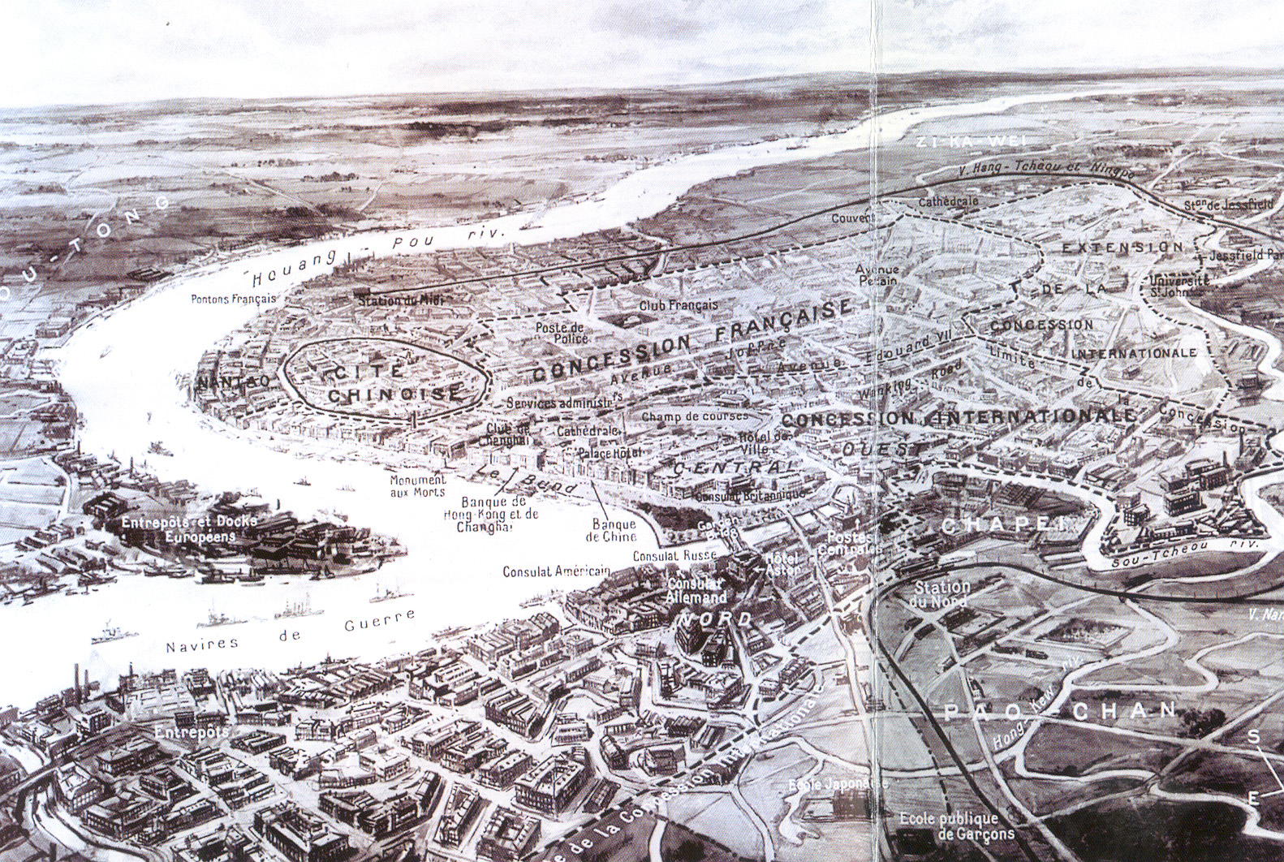
Shanghai, ca. 1930

Slide 3
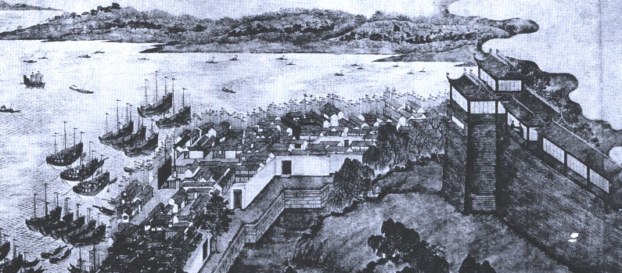
Panorama of Shanghai ca. 1815
This Chinese painting shows the walls of Shanghai (at right) and the waterfront shops and warehouses of local Chinese merchants
Harbor is filled with Chinese junks, not foreign vessels

Slide 4
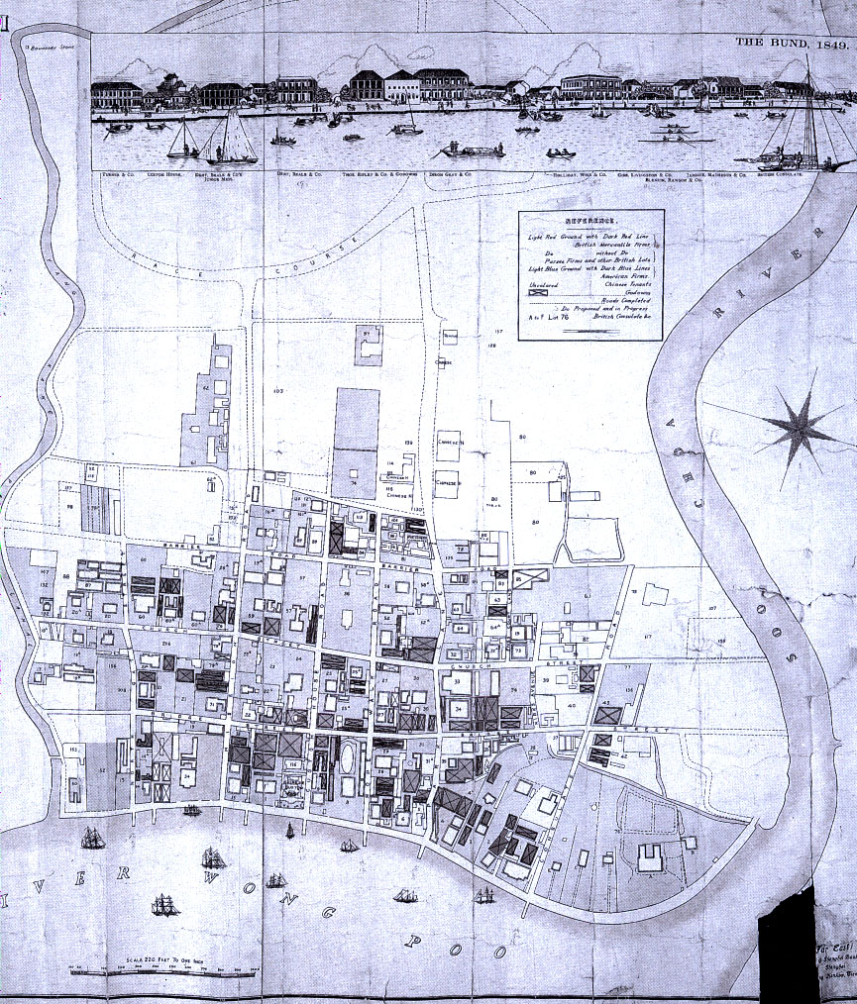
Map of Shanghai’s Foreign Settlement, 1855
At the top of the map the buildings along the Bund (Shanghai’s waterfront) are depicted

Slide 5
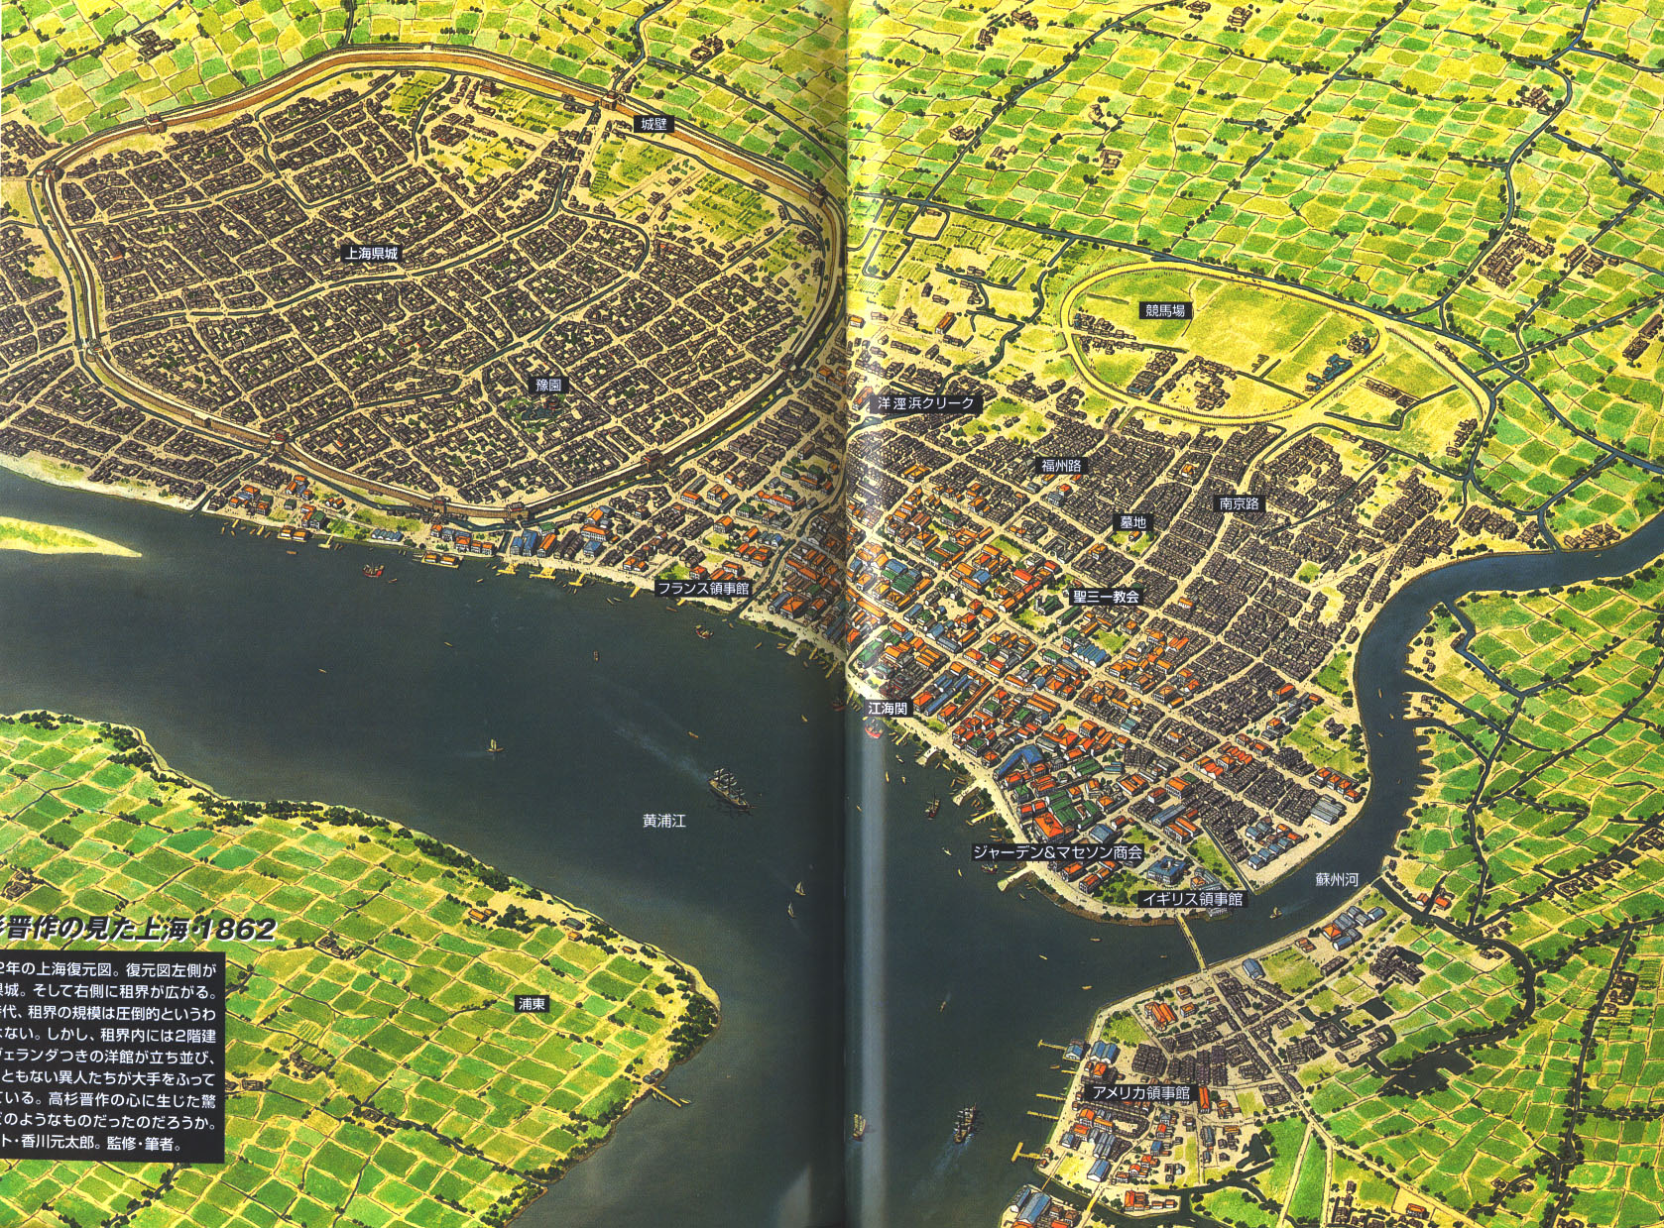
Shanghai in 1862

Slide 6
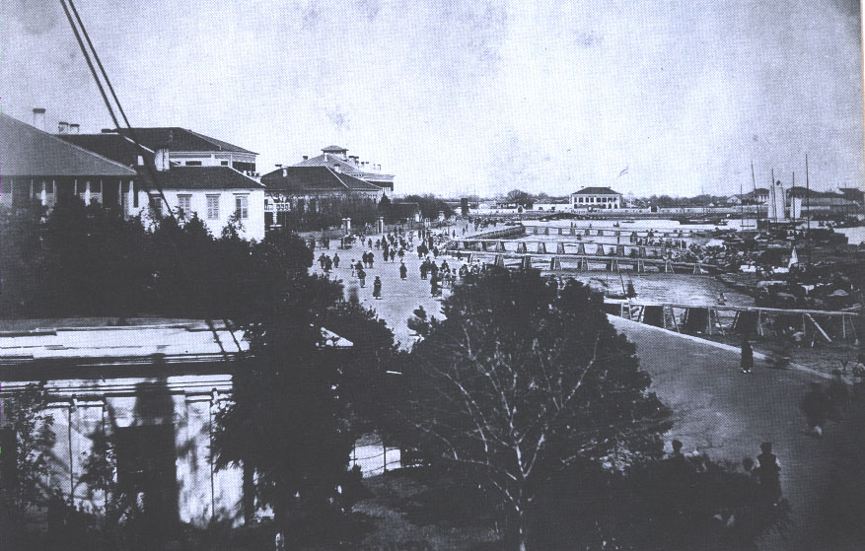
Shanghai Bund in 1860

Slide 7
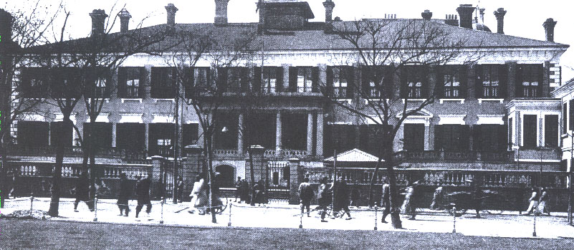
Headquarters of Jardine, Matheson & Co.
Jardine, Matheson became the dominant foreign company in China, with investments in shipping, mines, railroads, and cotton mills
The company’s Shanghai headquarters, built in 1851, was one of the landmark buildings along the Bund

Slide 8
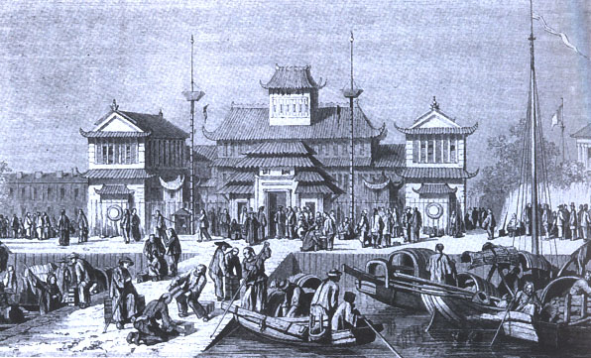
Shanghai Customs House, 1857

Slide 9
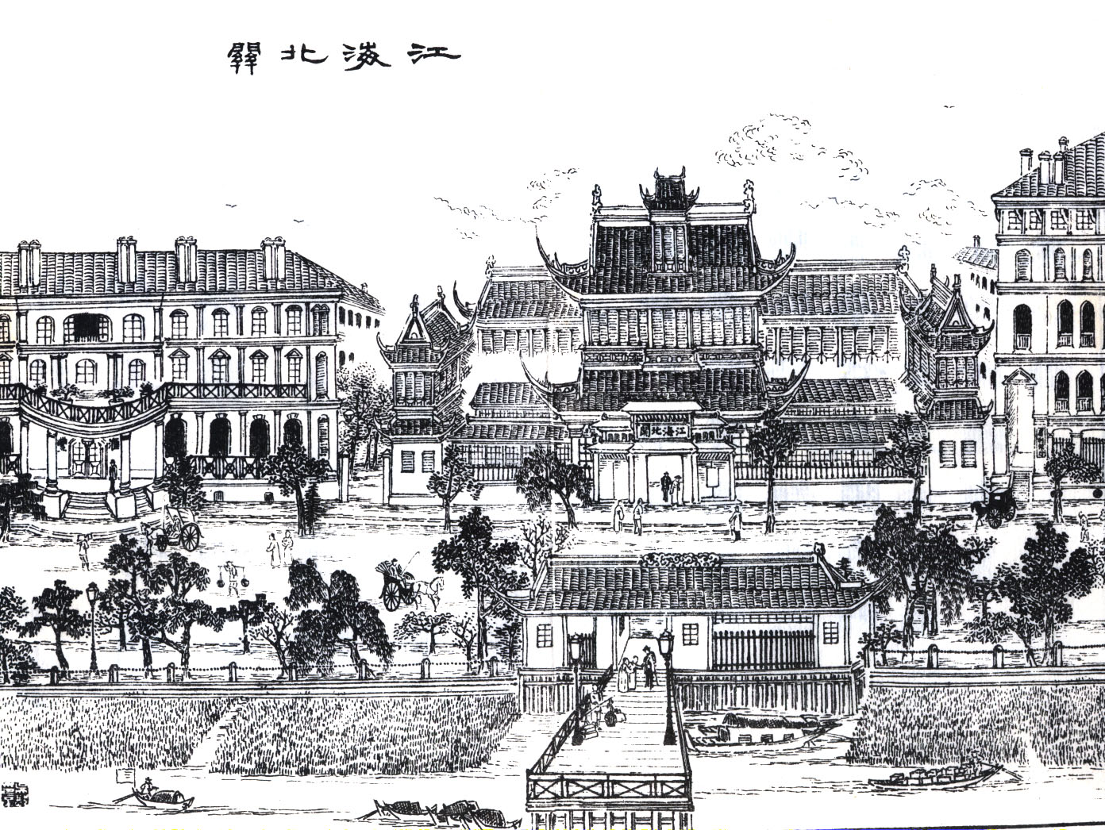
Shanghai Customs House
The only Chinese-owned building along the Bund, the
Customs House still was managed by foreigners

Slide 10
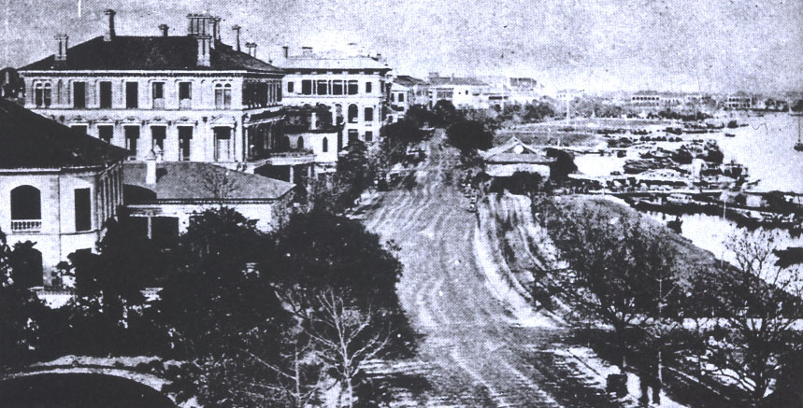
Shanghai Bund in 1880
The most prominent building at left is Dent & Co., the
first and foremost of Shanghai’s opium trading firms

Slide 11
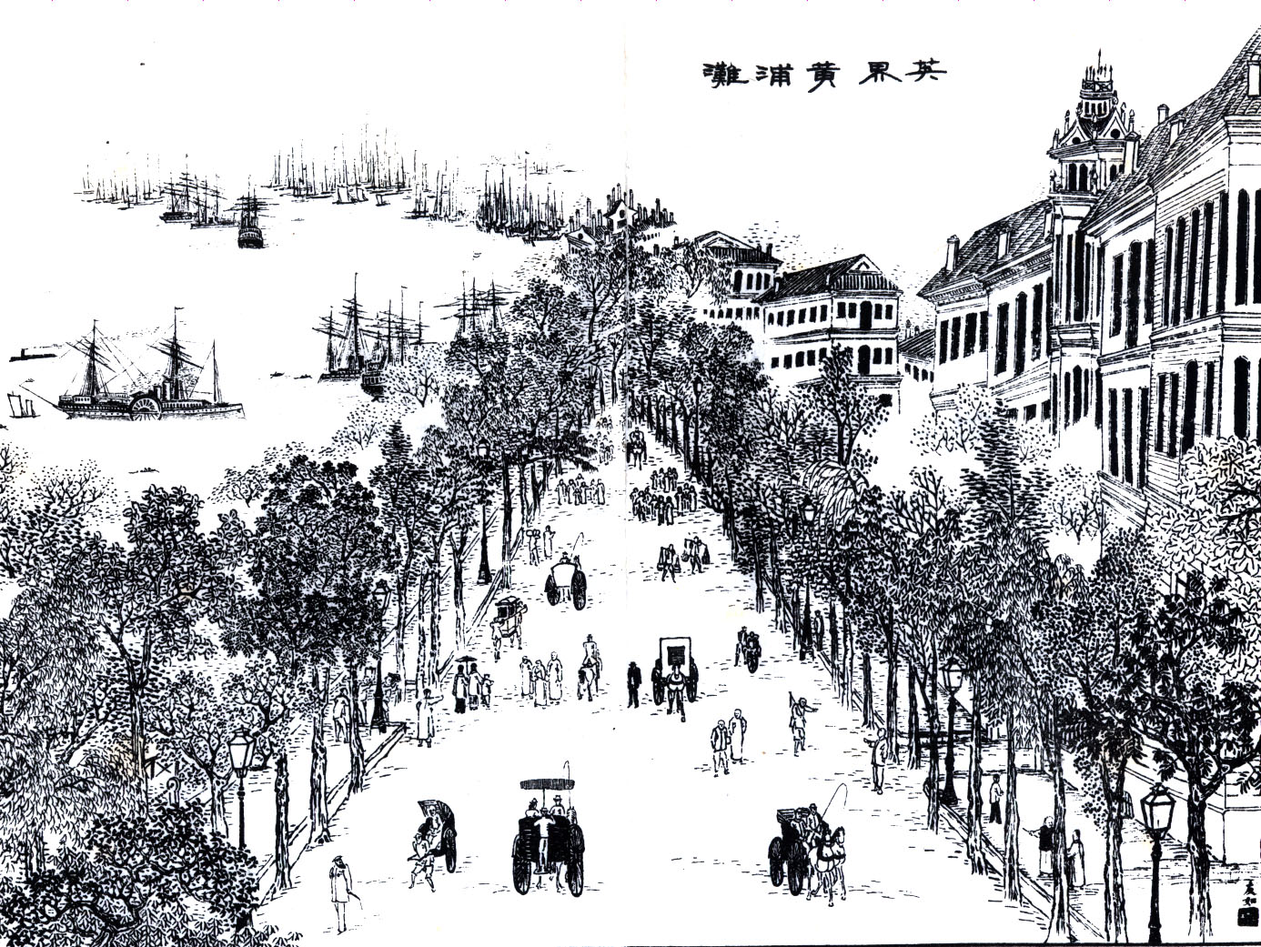
Chinese View of the Bund, 1884
Foreigners predominate on the promenade along the Bund
From Splendid Sights of Shanghai 申江勝景圖 (1884)

Slide 12
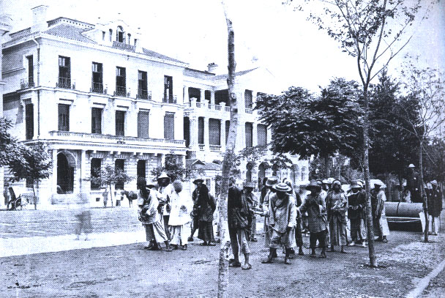
Street Paving by Chinese Convict Laborers

Slide 13
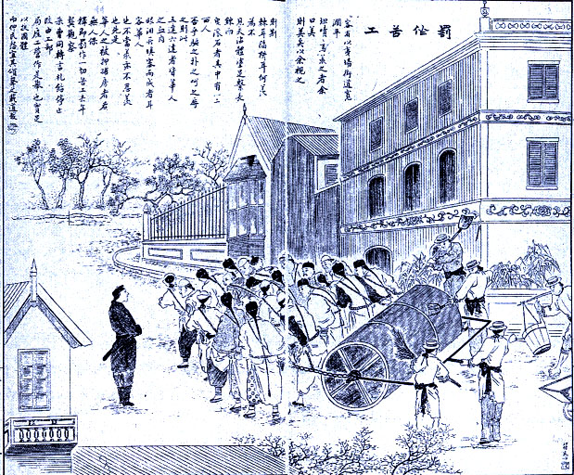
Street Paving by Chinese Convict Laborers
1887 issue of
Dianshizhai
Pictorial wrote that
the wide roads of
the International
Settlement were
paved “with the
blood and tears of
Chinese”

Slide 14
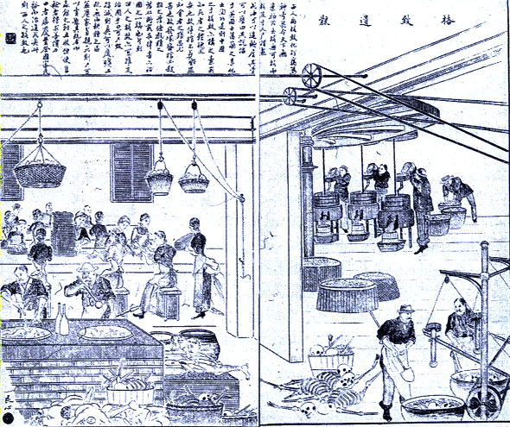
Corpses Into Fertilizer
This 1888 illustration from Dianshizhai Pictorial depicts one of the “innovations” of Western science
The article notes that this technology allows the poor to save funeral expenses and earn some money for their descendants

Slide 15
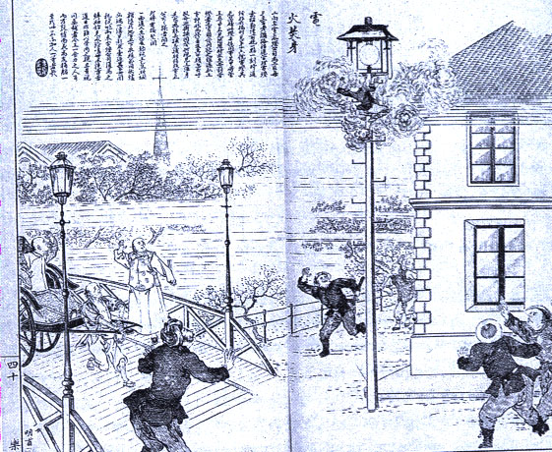
Death by Electric Shock
Modern technologies also had their risks: here an electric company employee is killed while inspecting a street lamp
Electric lighting was introduced to Shanghai in 1890, but only in the Western-governed parts of the city

Slide 16
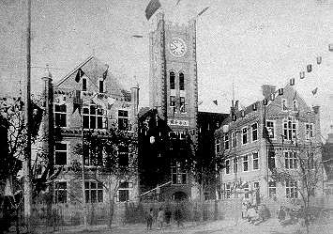
Shanghai Customs House, 1893
The opening of the new Customs House (modeled after a
British city hall) coincided with the 50th anniversary
of the opening of Shanghai as a treaty port

Slide 17
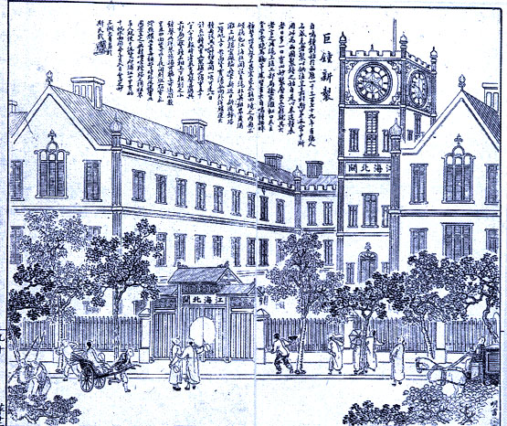
Customs House Clock Tower
1893 issue of Dianshizhai Pictorial shows the new Customs House
The text mentions the chiming clock tower, its face lit by electric lights, as the novel and most impressive feature of the new building

Slide 18
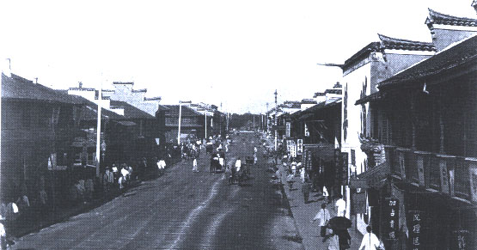
Nanjing Road in the Late 19th Century
The main street of Shanghai since the 1920s, in the 19th century
Nanjing Road was the main commercial artery for the Chinese
population of the International Settlement

Slide 19
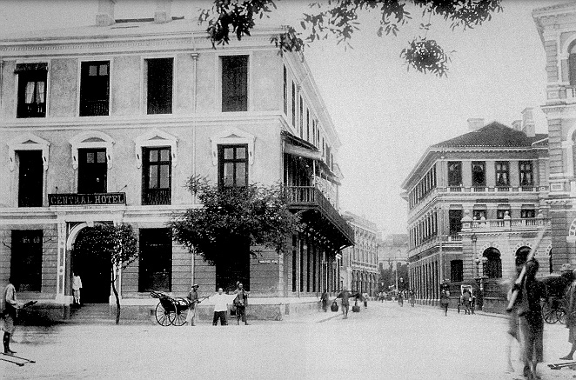
Entrance to Nanjing Road, 1903
Left: Central Hotel
Right: Sassoon & Co. (now the site of the Peace Hotel)

Slide 20
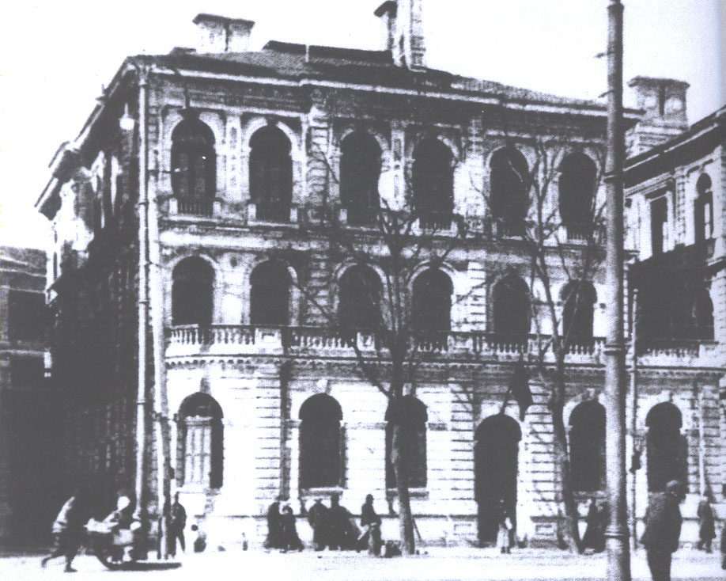
Sassoon & Co.
David Sassoon, from a successful Jewish merchant family in Baghdad, opened an opium trading firm in Shanghai in 1849
In the late 19th century Sassoon & Co. diversified into textiles, insurance, and real estate

Slide 21
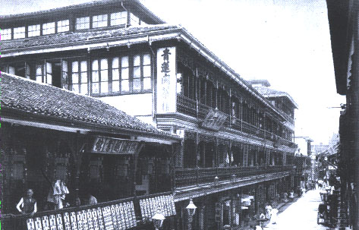
Fuzhou Road in the late 19th Century
Fuzhou Road, a popular gathering place because of its teahouses (like the Green Lotus, shown here), became the center of Shanghai’s publishing industry and literary culture in the 1920s

Slide 22
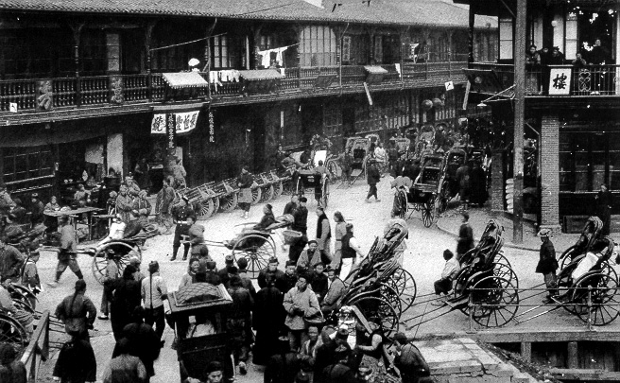
Rickshaws at the North Gate, ca. 1890
Introduced from Japan in 1873, rickshaws became a symbol both
of modernity (steel frames and rubber tires) and
China’s subordination to the West

Slide 23
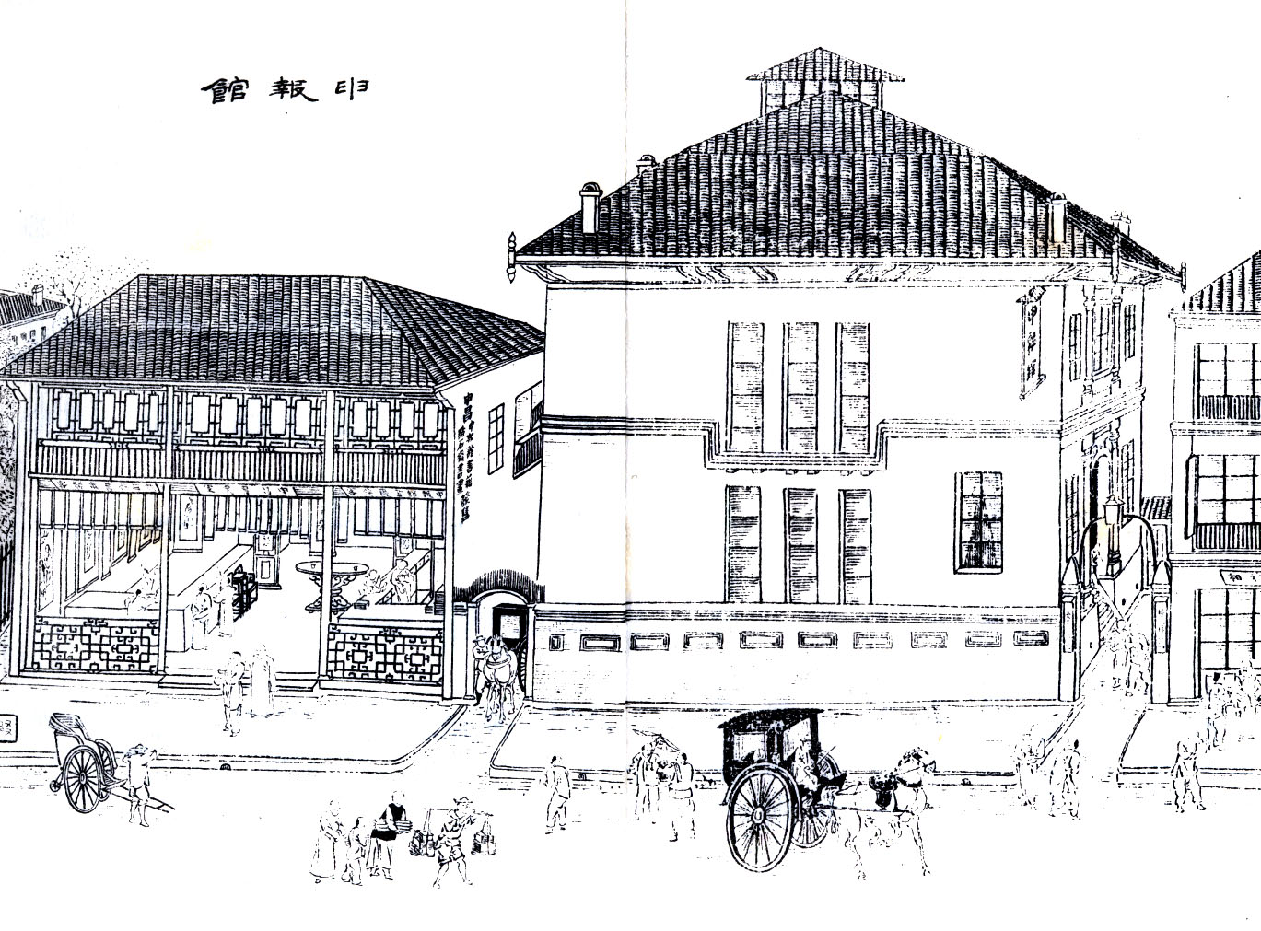
Offices of Shanghai Gazette
(Shenbao 申報)
Founded as
Shanghai’s first
Chinese-language
newspaper in
1872 by a British
entrepreneur,
Shenbao aimed to
“introduce new
knowledge”

Slide 24
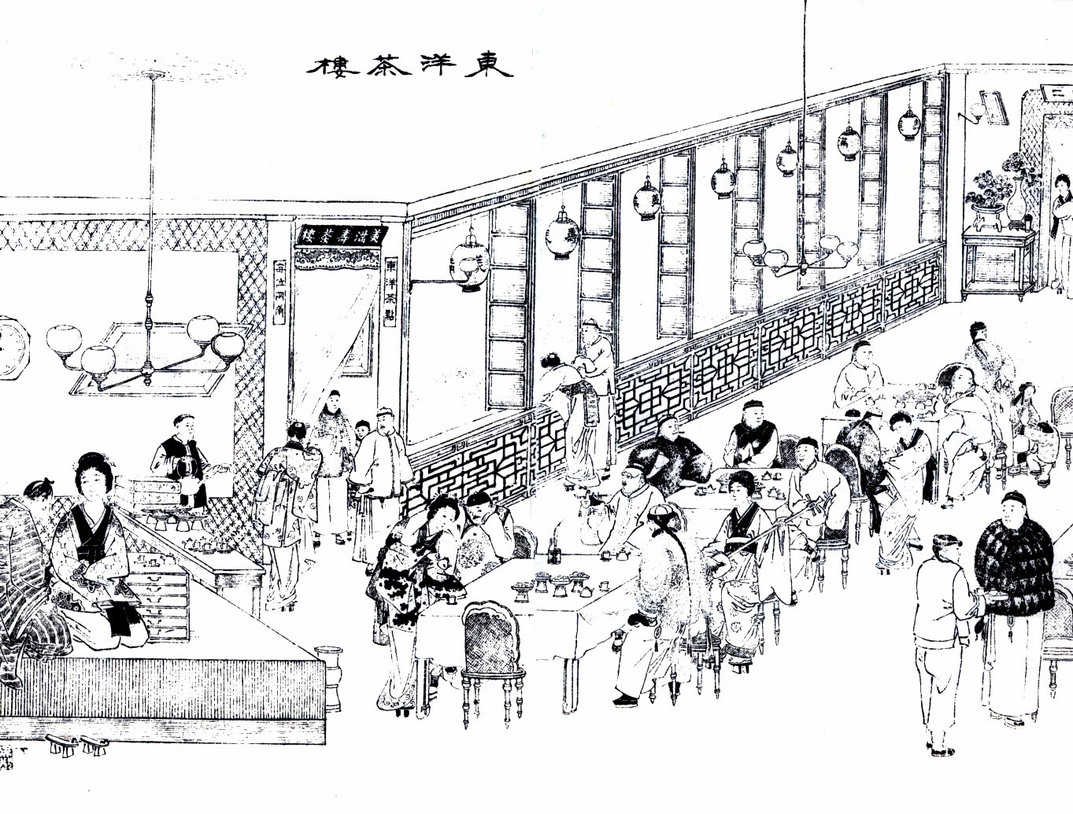
Japanese Teahouse
Japanese tastes and fashions, unfamiliar to 19th century
Chinese, contributed to the exotic cultural life of Shanghai

Slide 25
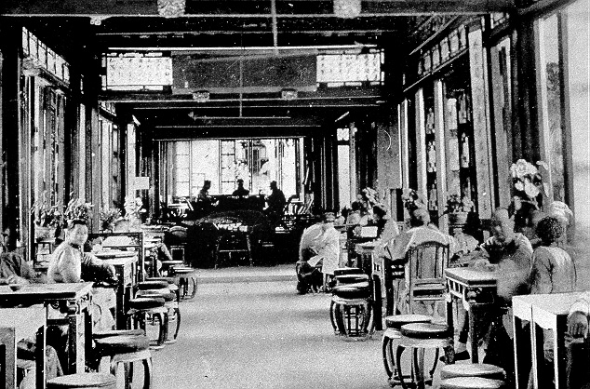
Cantonese Teahouse
Cantonese clustered in the Hongkou district, north of Suzhou Creek,
an area also popular with American and Japanese residents

Slide 26
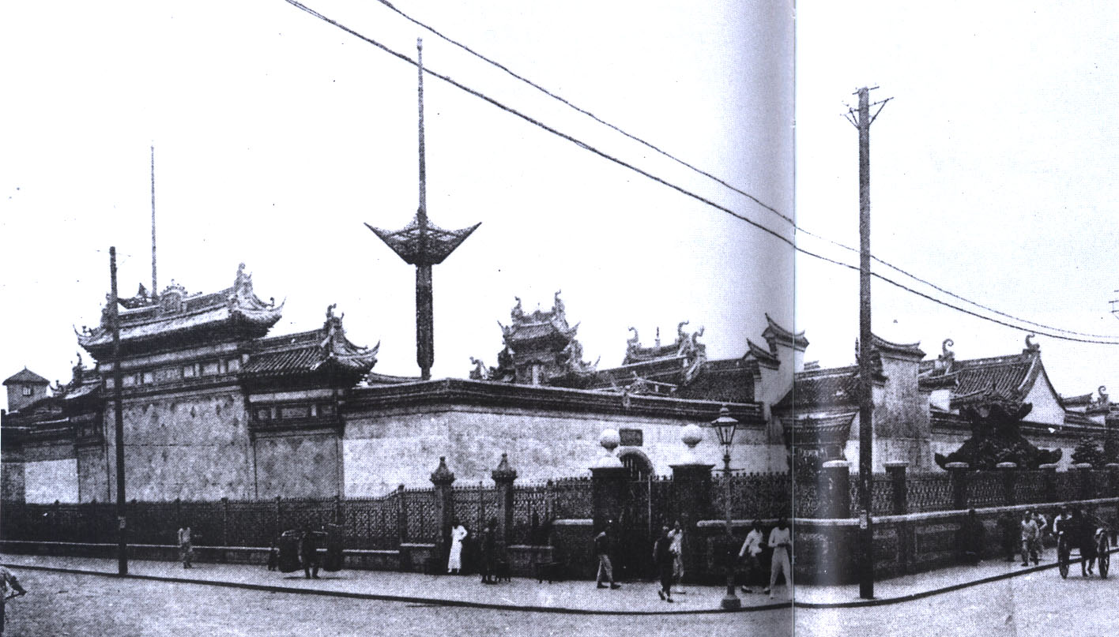
Chinese Bankers’ Guildhall
The guildhall represented Shanghai’s hundreds of traditional-style banks (no modern banks were founded by Chinese until 1897)
Built in 1889 in the Chinese city, in a purely Chinese style of architecture

Slide 27
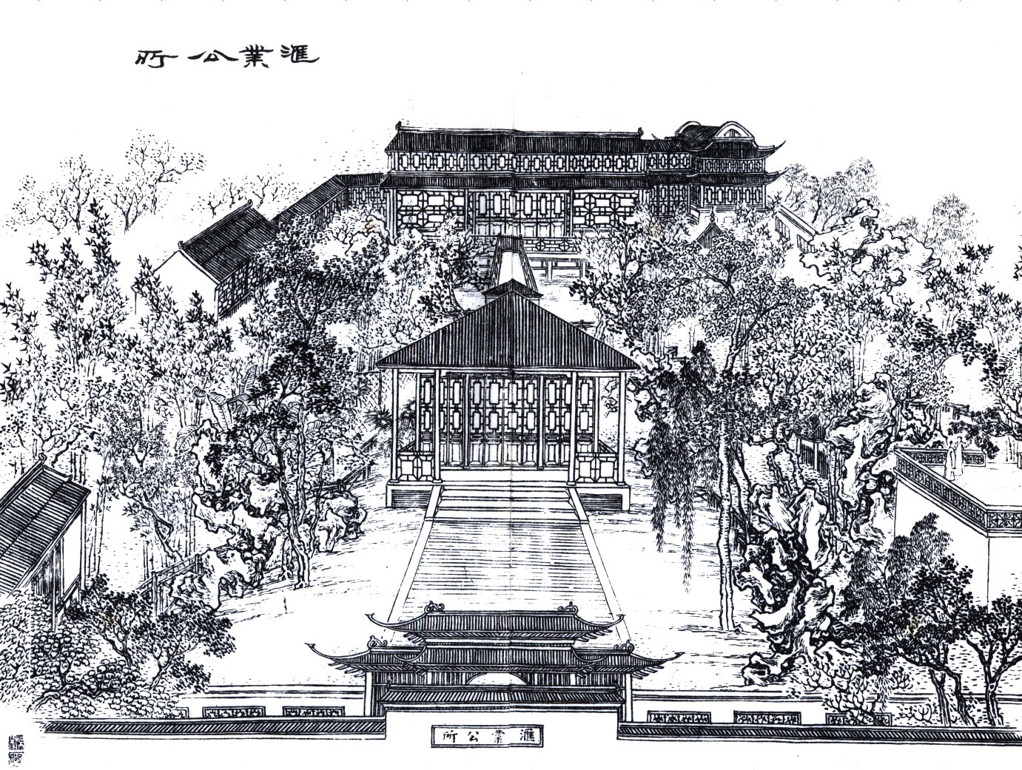
Chinese Bankers’ Guildhall
The original
bankers’
guildhall
was housed in its
own exclusive
garden in
Shanghai’s City
God Temple,
adjacent to the
famous Yu
Garden

Slide 28
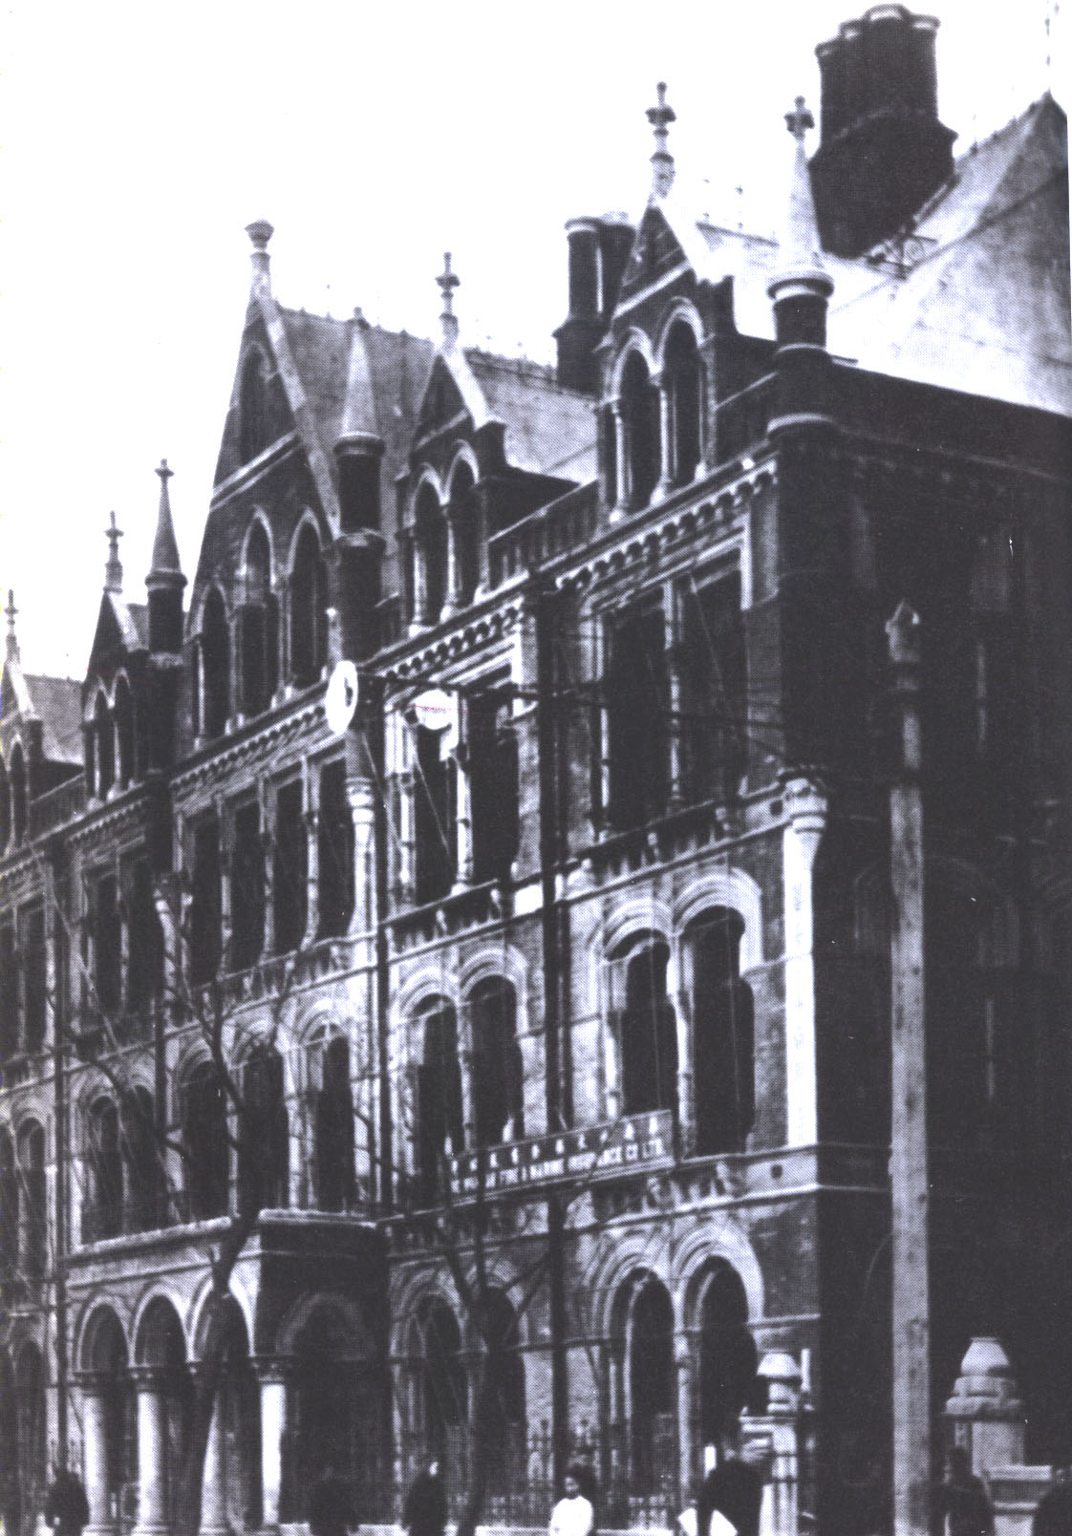
Imperial Bank of China
Founded in 1897 by Sheng Xuanhuai as China’s first modern bank (most of its capital was supplied by the imperial government)
Building was constructed in Queen Anne style
Ceased operations with fall of Qing dynasty in 1911

Slide 29
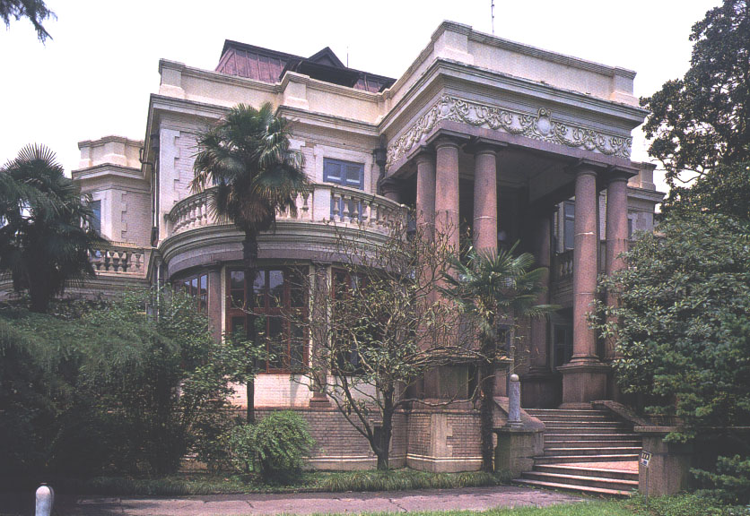
Home of Sheng Xuanhuai
Sheng (1849-1916), a Qing dynasty official, established
China’s first modern bank in Shanghai in 1897

Slide 30
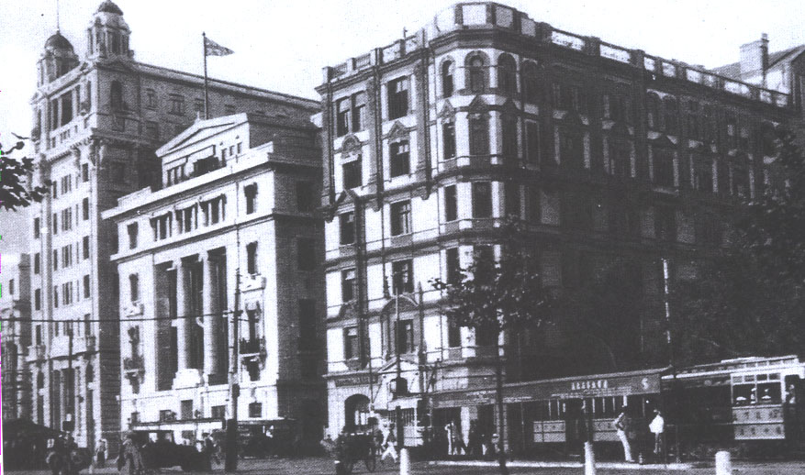
Palace Hotel
Built in 1906 at the foot of Nanjing Road, the Palace Hotel (at right) was Shanghai’s first steel-frame “skyscraper”
This photo shows bank buildings at left built in the 1920s

Slide 31
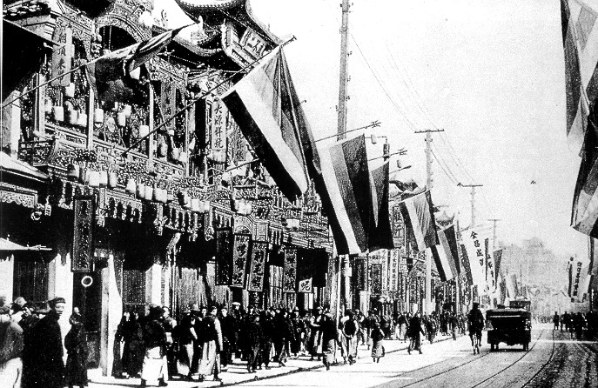
1911 Revolution in Shanghai
Nanjing Road lined with revolutionary flags

Slide 32
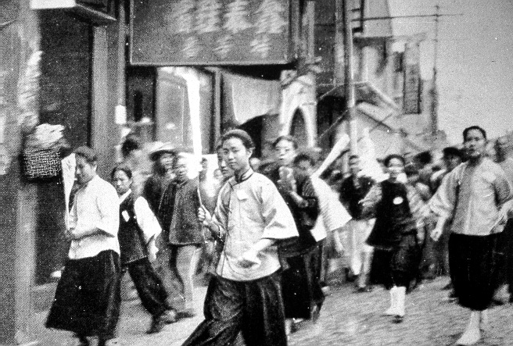
Student Demonstrations
The May 4th Movement in Shanghai

Slide 33
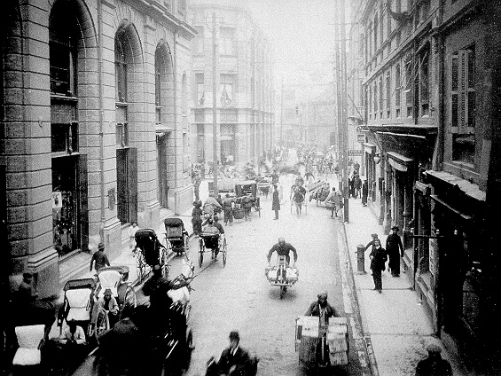
Intersection of Nanjing and
Sichuan Roads, 1915

Slide 34
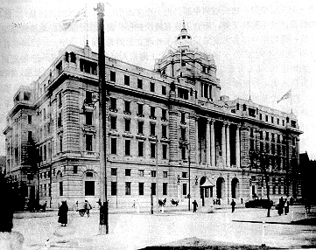
Hong Kong & Shanghai Bank (1923)

Slide 35
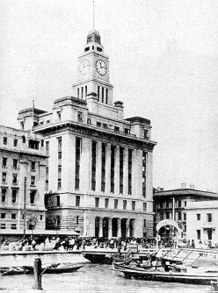
Shanghai Customs House
1926

Slide 36
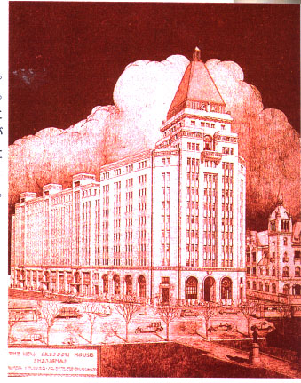
Sassoon House
Built in 1929 on the site of the Sassoon trading firm, the new hotel faced the Bund at the foot of Nanjing Road
By the 1890s the Sassoon fortune was based on real estate rather than opium
Now known as the Peace Hotel

Slide 37
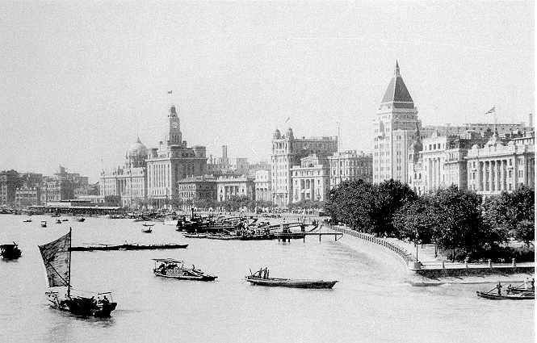
Shanghai Bund, 1929
3
3
7
2
9
8
10
5
6
1
4

Slide 38
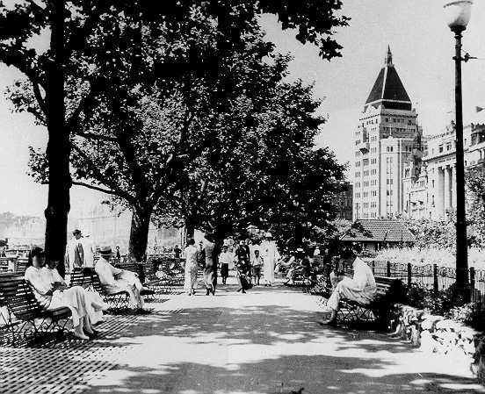
Promenade Along the Bund, 1932

Slide 39
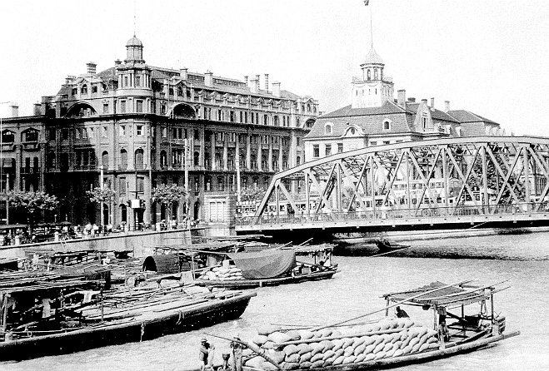
Garden Bridge, 1930
Left: Russian consulate

Slide 40
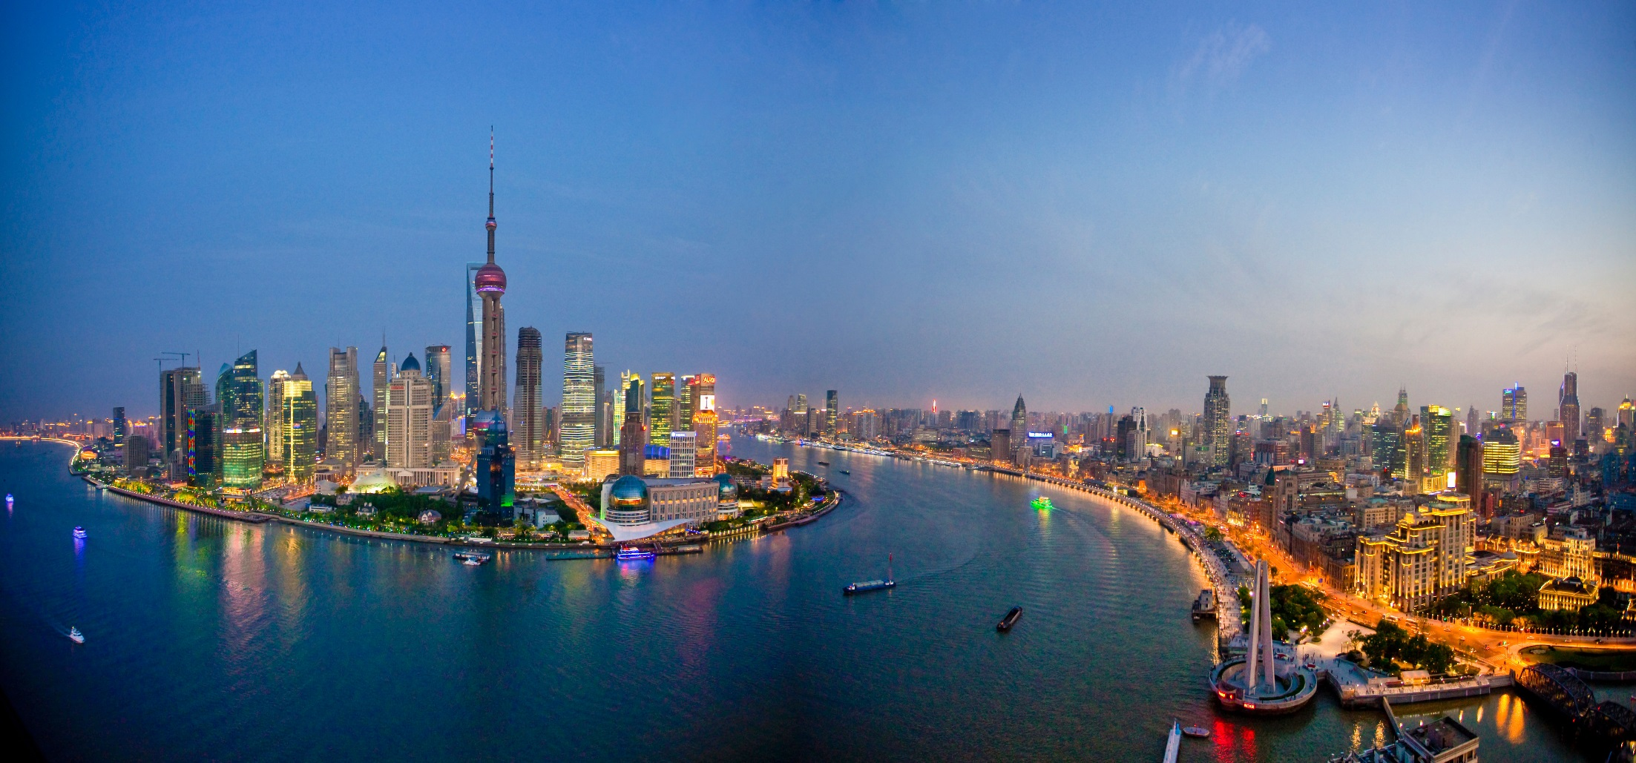
Shanghai Panorama Today

