Slide 1
Shanghai in Photographs (II):
1920s-30s

Slide 2
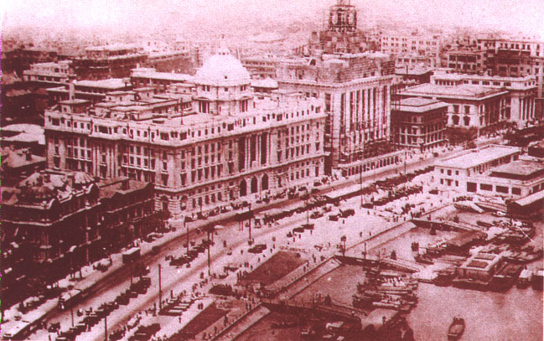
Shanghai Bund in 1925

Slide 3
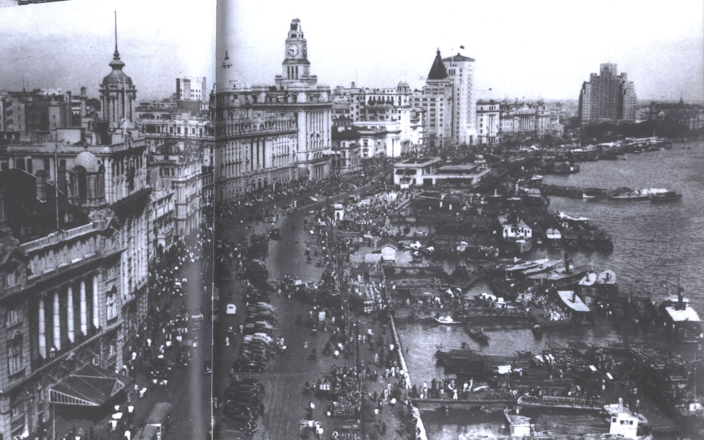
Shanghai Bund in the 1940s
Additions to the Shanghai skyline included Broadway Mansions
(right rear) and the Bank of China building (center, to the right of Sassoon House)

Slide 4
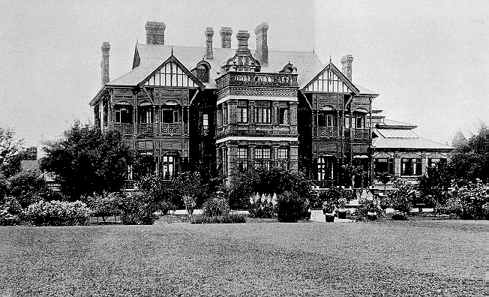
English Merchant’s Country House
Shanghai suburb of Xujiawei
As Shanghai became more urban, wealthy foreigners and Chinese increasingly moved to suburban mansions

Slide 5
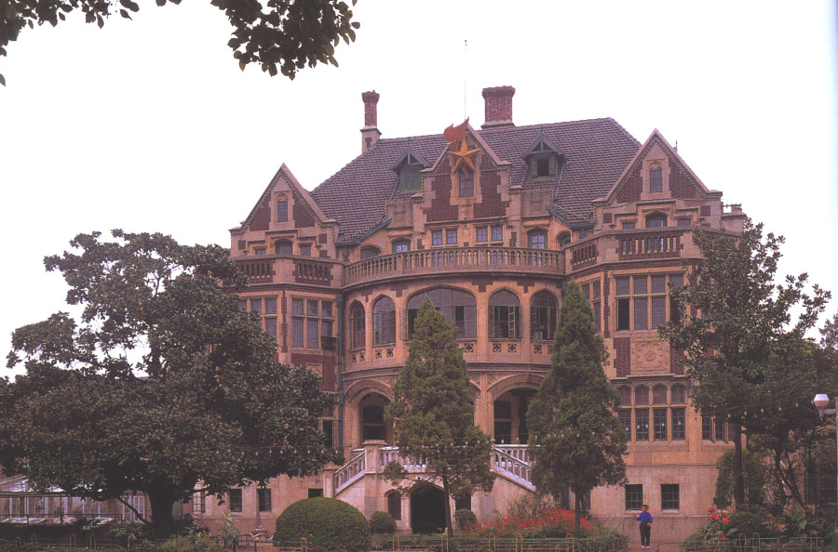
Wang Boqun Mansion (1930)
Minister of
Communications
in the Nationalist
government,
Wang built
his suburban
mansion in the
Victorian Gothic
style

Slide 6
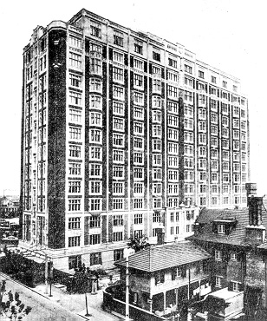
Huamao Apartments
Built in 1929 for British residents and tourists
On Maoming Road, at the border between the French Concession and the International Settlement

Slide 7
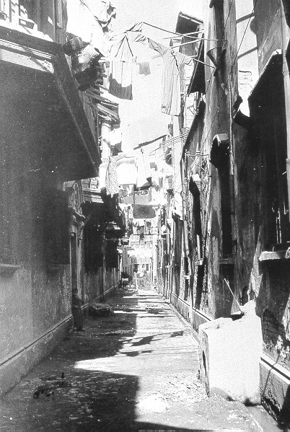
Shikumen
“Stone-Gate Alley”
These crowded residential districts became synonymous with the lifestyle of Shanghai’s “petty urbanites”

Slide 8
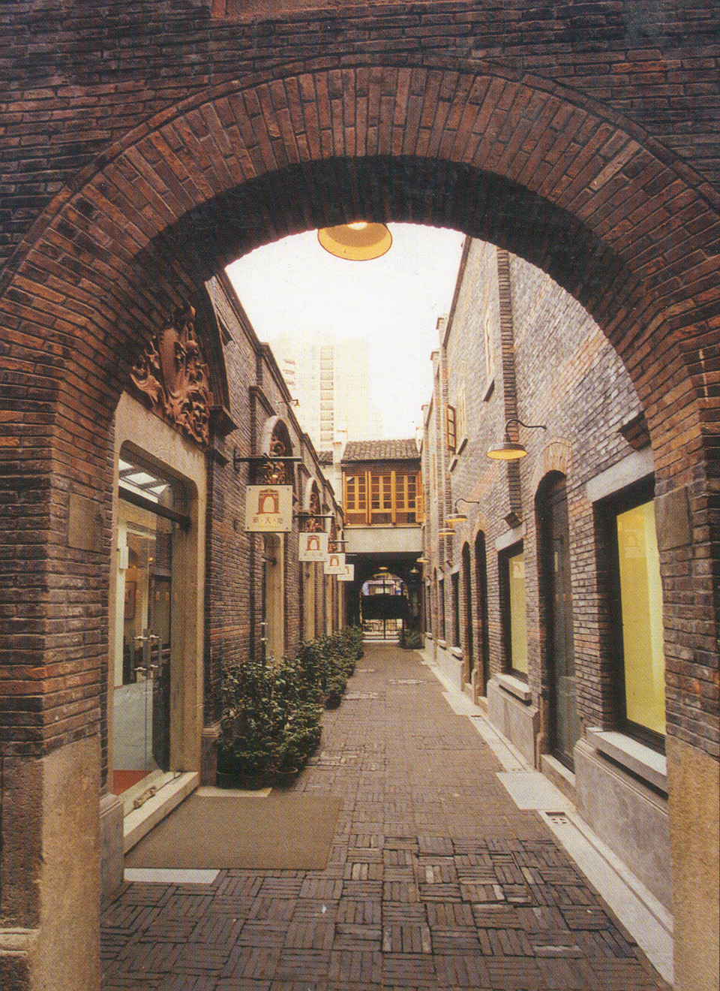
“Gentrified” Shikumen Alley

Slide 9
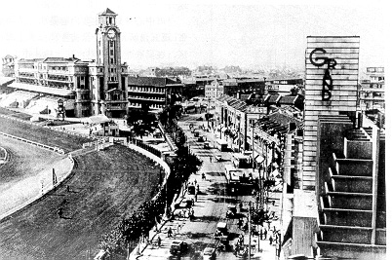
Racetrack & Clubhouse
(Nanjing Road at center)
Shanghai’s race course was originally laid out in 1850

Slide 10
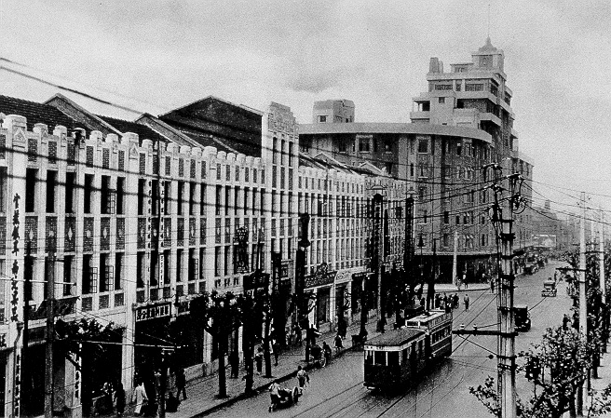
Trolley on Avenue Joffre, 1940
Main thoroughfare of the French Concession

Slide 11
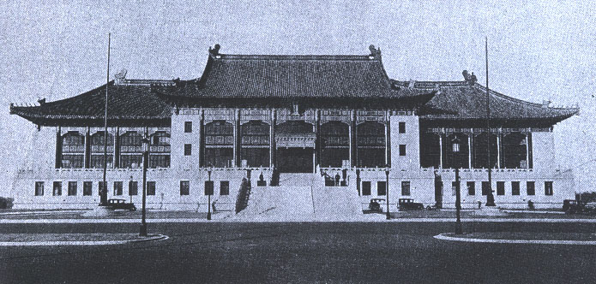
Shanghai City Hall, 1933
The new city hall built by the Nationalist government imitated the
palatial architecture of Beijing’s Forbidden City on a more
monumental scale while deliberately rejecting foreign styles

Slide 12
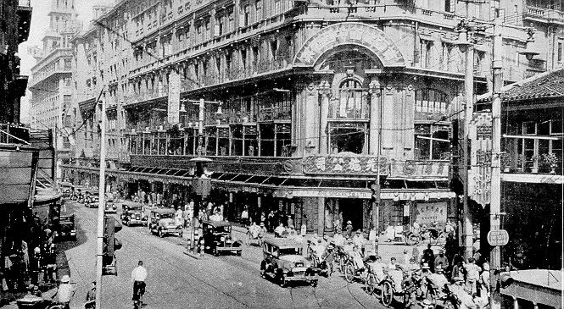
Sincere (Xianshi) Department Store
Opened in 1917 on Nanjing Road by an overseas
Chinese entrepreneur in Australia

Slide 13
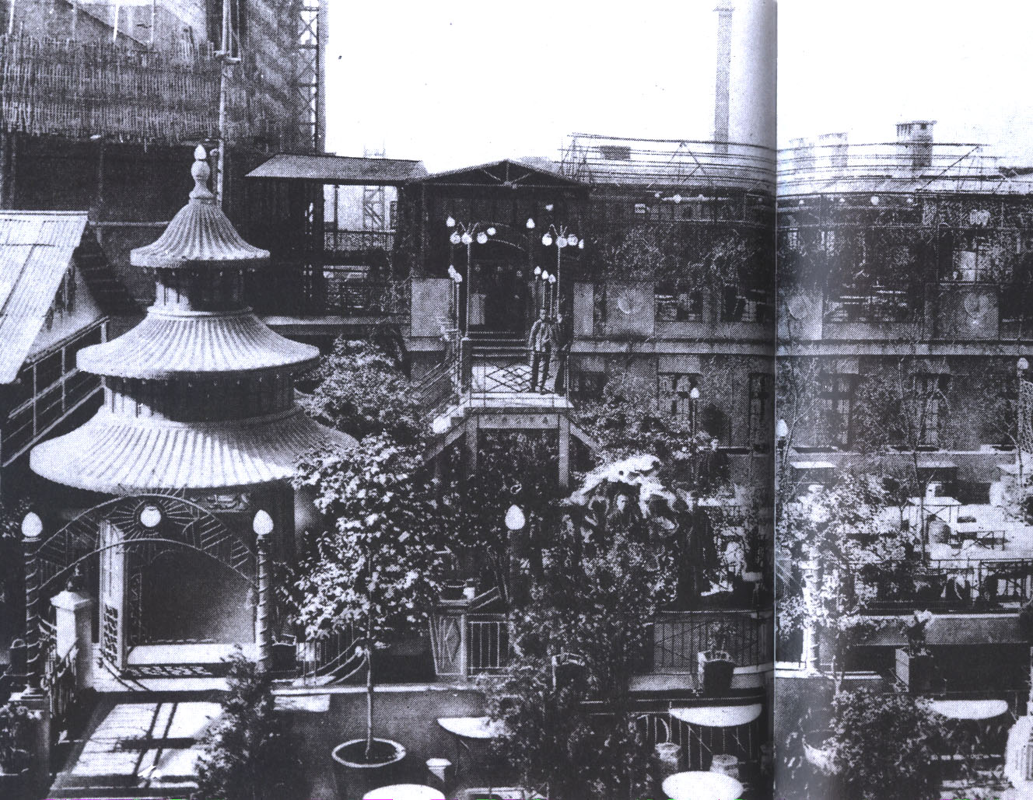
Roof Garden of Sincere Department Store

Slide 14
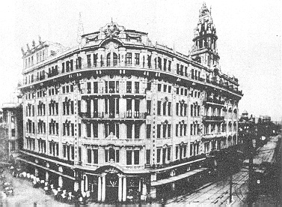
Wing On Department Store
Opened in 1918 on Nanjing Road with a staff of 400 salesclerks

Slide 15
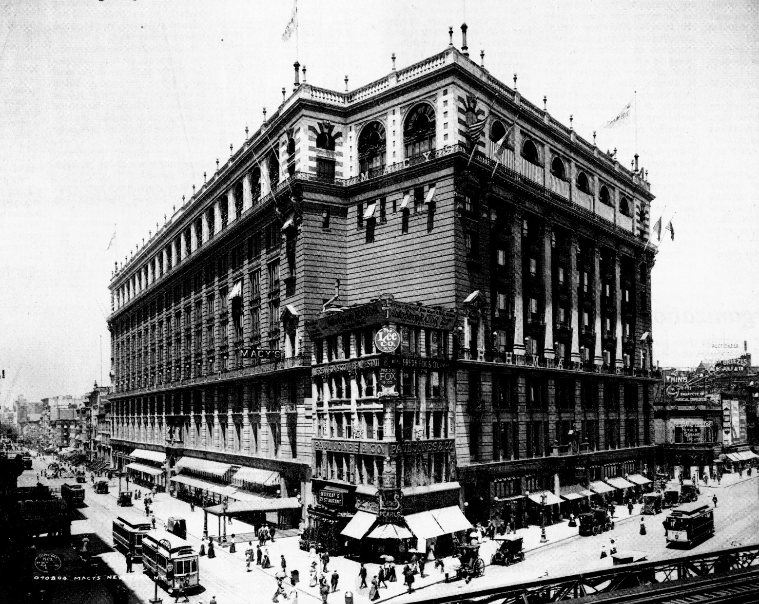
Macy’s Department Store
Herald Square,
New York City,
ca. 1905

Slide 16
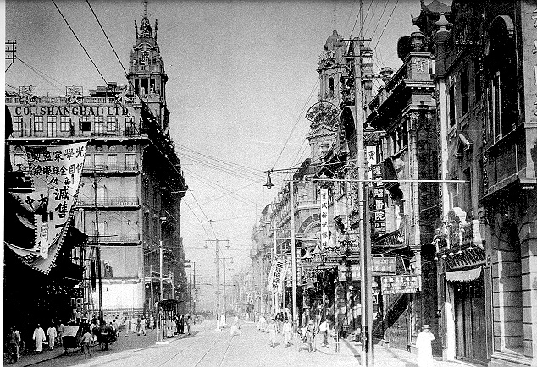
Nanjing Road Department Stores
Wing On at left; Sincere at right

Slide 17
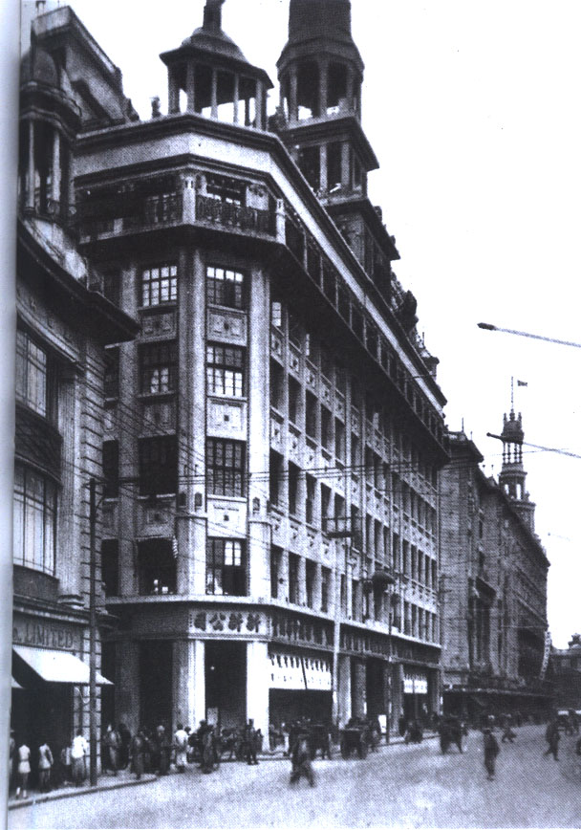
Sun Sun (Xinxin) Department Store
The third of Shanghai’s four major department stores, Sun Sun opened in 1926 on Nanjing Road, immediately west of Wing On (at rear)
First air-conditioned store in Shanghai
Had own radio station to broadcast specials

Slide 18
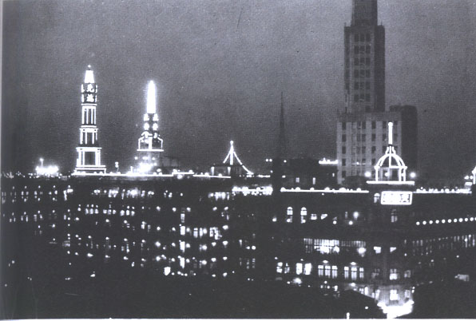
Shanghai Department Stores at Night
(Wing On at left, Sincere at center, Xinxin at right)

Slide 19
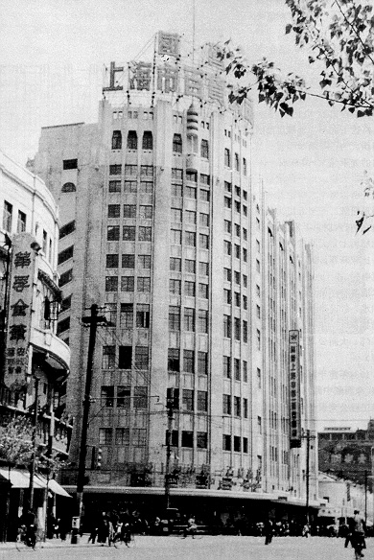
Sun Co. (Daxin)
Department Store
Opened in 1934 at intersection of Nanjing Road and Tibet Road, across from the race track (now People’s Park)
Built in American Art Deco style

Slide 20
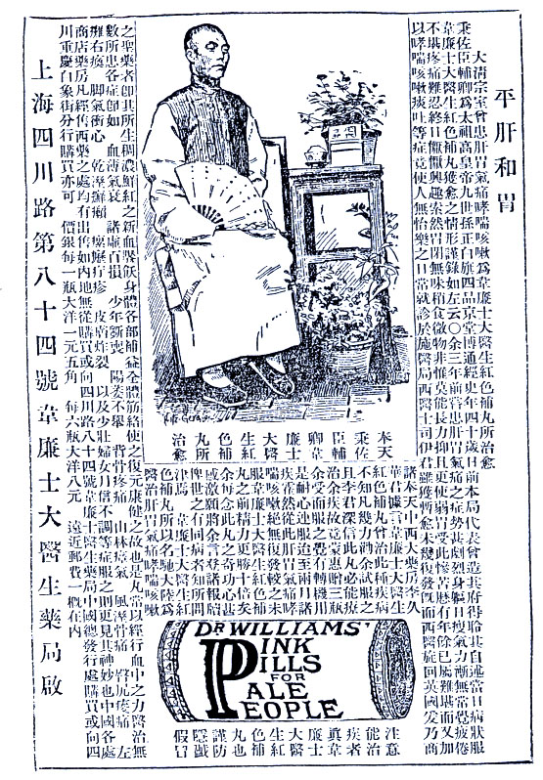
Newspaper Advertisement for Dr. William’s Pink Pills
From 1910 Chinese newspapers begin to fill up with pictorial advertisements
This 1910 advertisement for Western medicine shows a member of the imperial family (in formal photography pose) whose liver ailments were cured by Dr. William’s pink pills

Slide 21
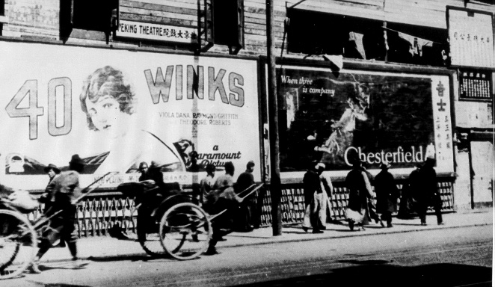
Billboards
Advertising American cigarettes and movies near the Bund

Slide 22
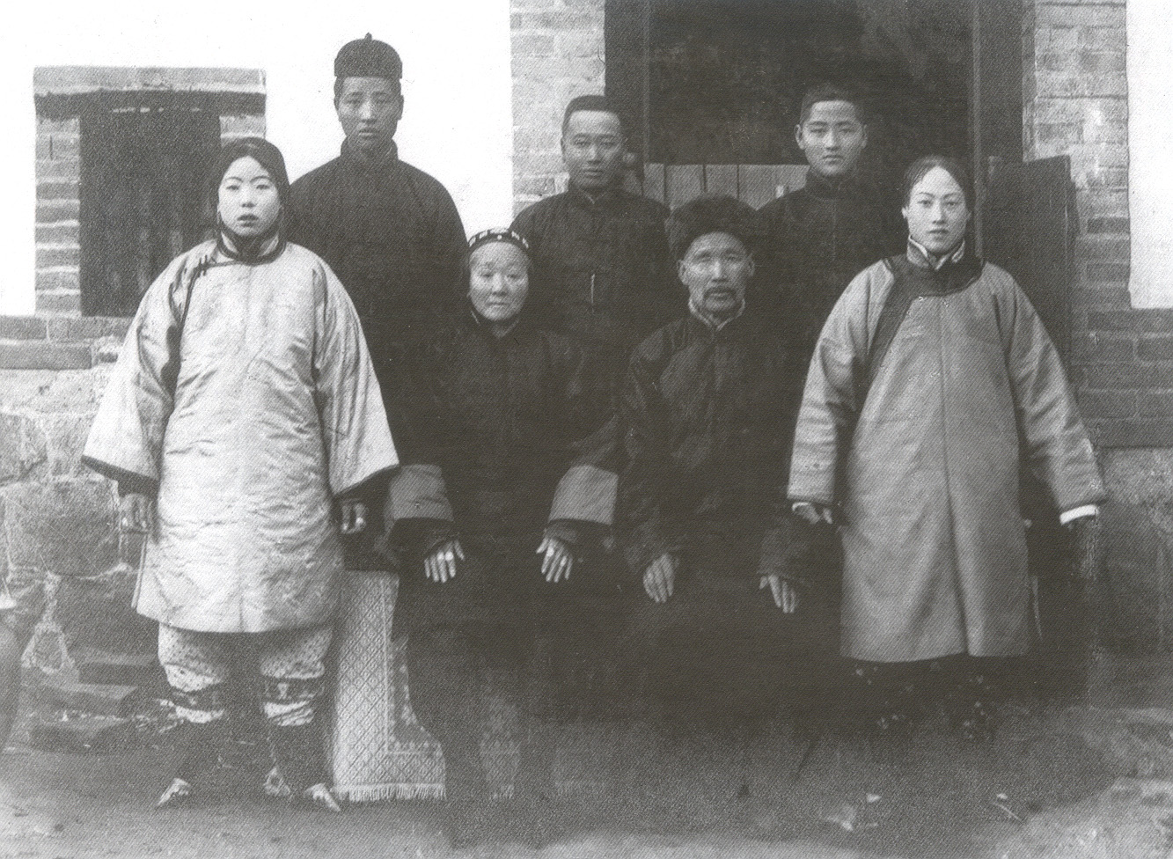
Han Family Portrait, ca. 1900

Slide 23
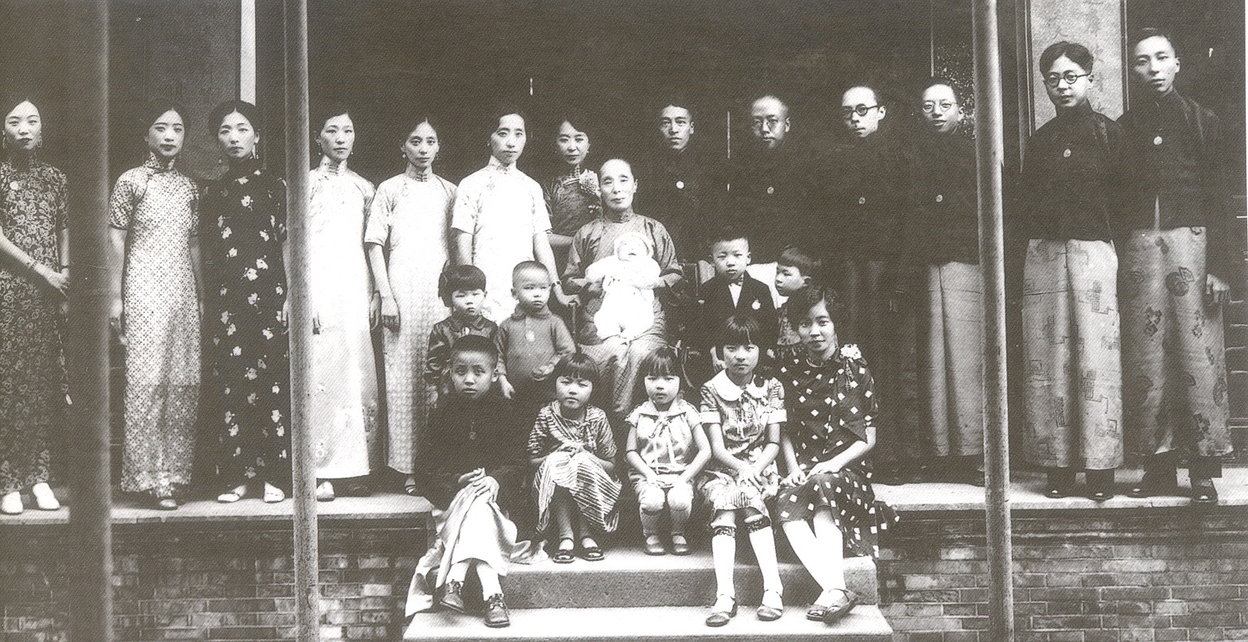
Liu Family Portrait, 1933

Slide 24
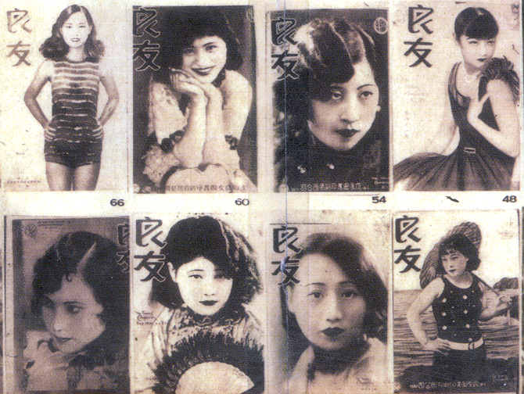
Cover Girls from Young Companion
(良友畫報) Magazine, 1932-33

Slide 25
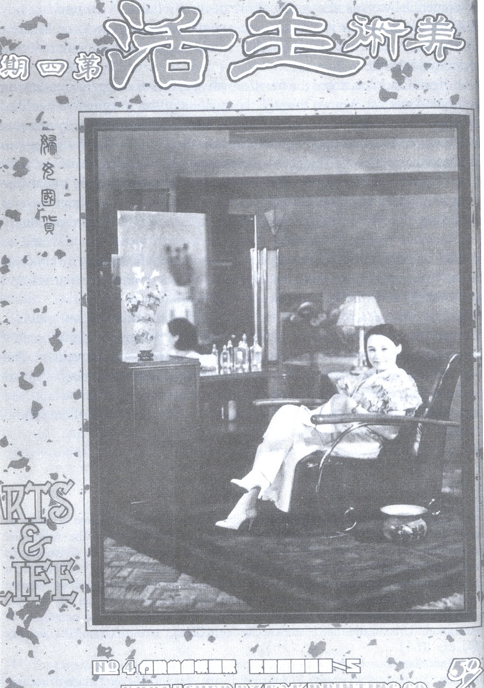
Cover of “Arts and Life” Magazine from 1934
Aimed at middle-class women readers, “Arts and Life” promoted a patriotic (“Buy Chinese Goods”) form of consumerism, but still showcased a distinctly “modern” (Western) lifestyle

Slide 26
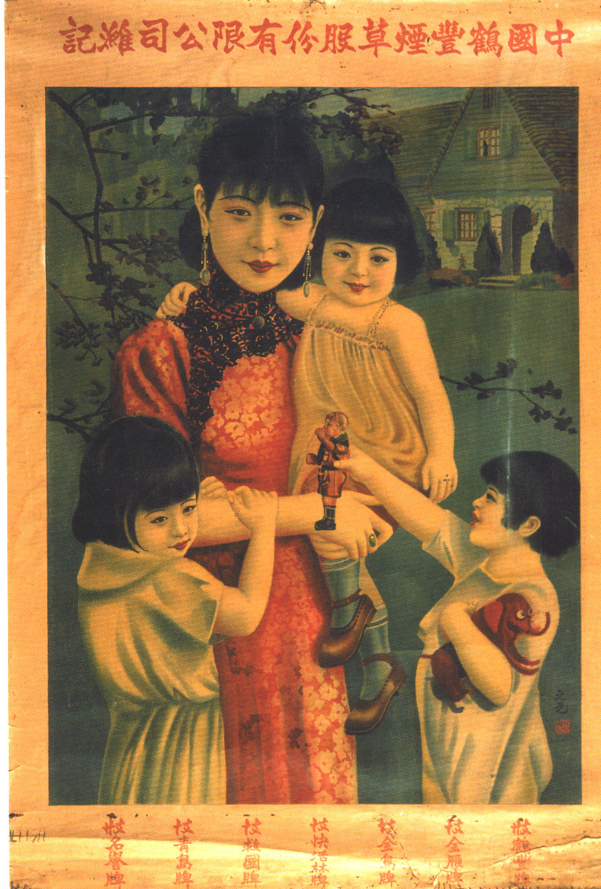
Mother and Children
This cigarette advertisement from the 1930s, in keeping with the new emphasis on domestic virtues, depicts an elegantly but conservatively dressed mother with children in Western clothing against a backdrop of a suburban Western-style home

Slide 27
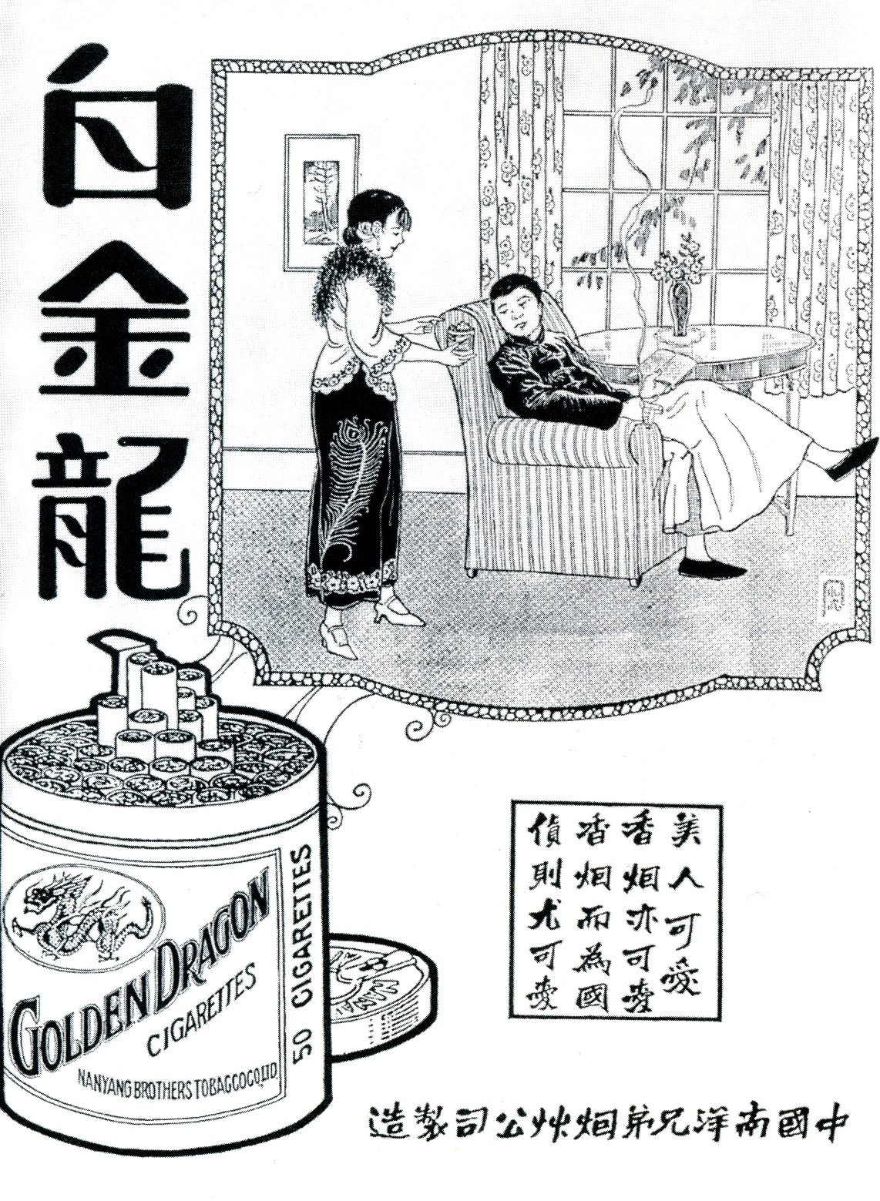
Cigarette Advertisement
Fashionable couple at leisure in modern home
Caption compares female beauty and cigarettes as both “lovely”
Also emphasizes that these cigarettes are “Made in China”

Slide 28
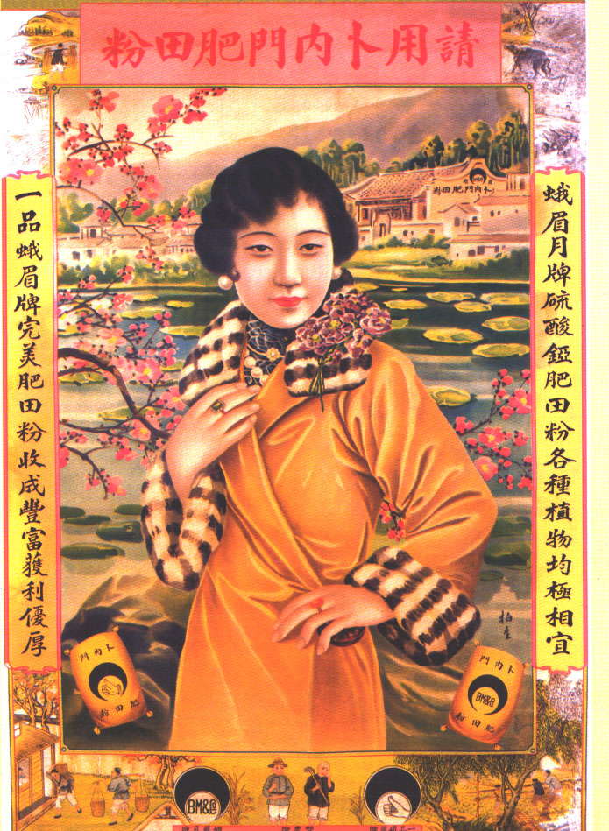
Advertisement with Fashionably-Dressed Model

Slide 29
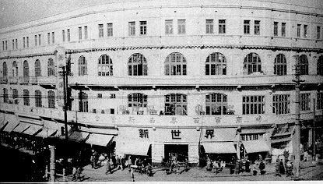
New World Arcade (1916)
Crammed with restaurants, theaters, and amusement arcades,
the New World was a magnet to Shanghai’s “petty urbanites”

Slide 30
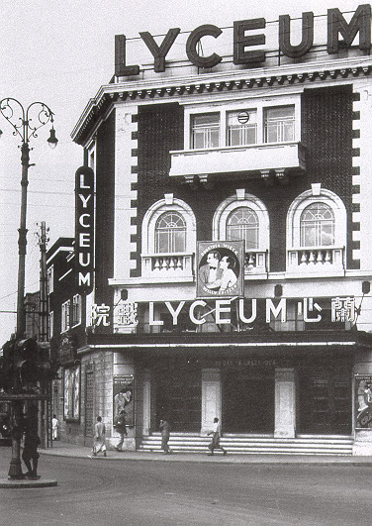
Lyceum Theater
Opened in 1931 in the French Concession
Featured theatrical performances and music concerts

Slide 31
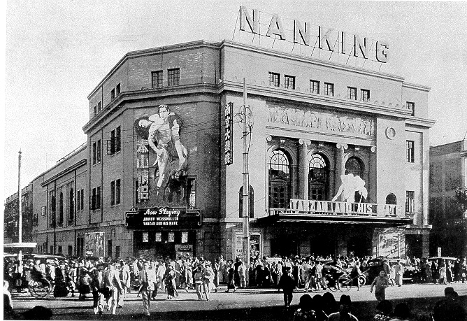
Nanking Movie Palace
Operated by a Chinese businessman, the Nanking had 1,500 seats

Slide 32
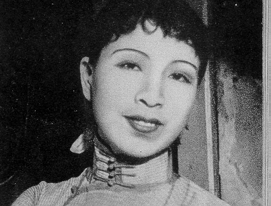
Lan Ping
Lan Ping (better known as Jiang Qing, wife of Mao Zedong) achieved fame with her first movie in 1933

Slide 33
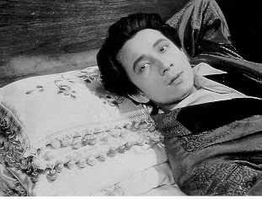
Yuan Muzhi
Director of “Street Angels” (1935)

Slide 34
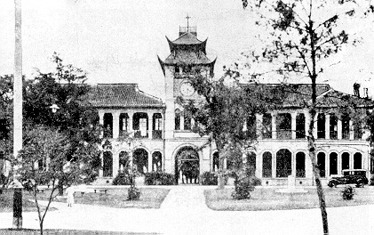
Benevolence Hall (1894)
St. John’s University

Slide 35
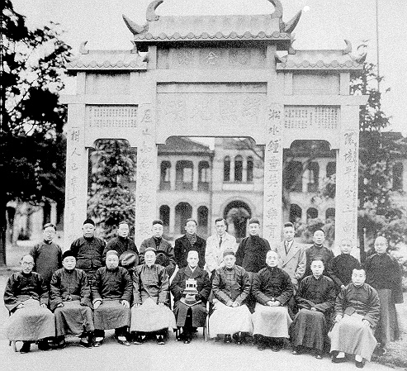
St. John’s University
Dedication of memorial arch, 1934
Francis Pott, president of St. John’s from 1886 to 1942, is seated at center

Slide 36
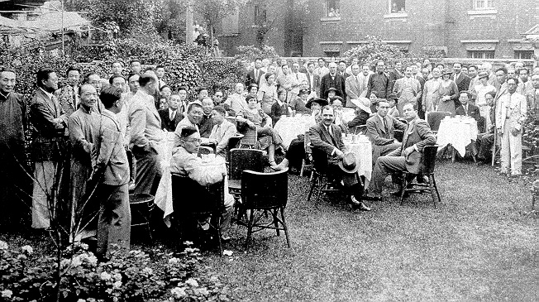
Sino-French Friendship Association
Garden party, 1933

Slide 37
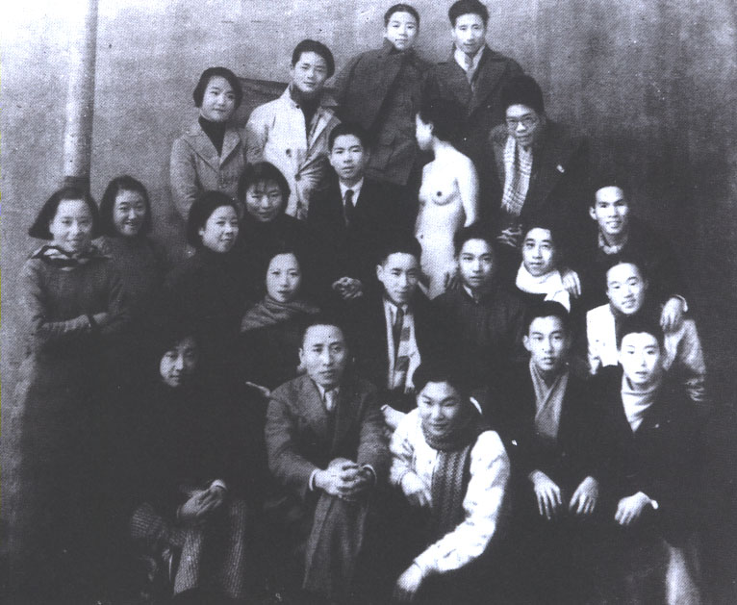
Art Students with Nude Model
Use of nude
models in
Western-style art
schools provoked
loud protests from
conservative
critics

Slide 38
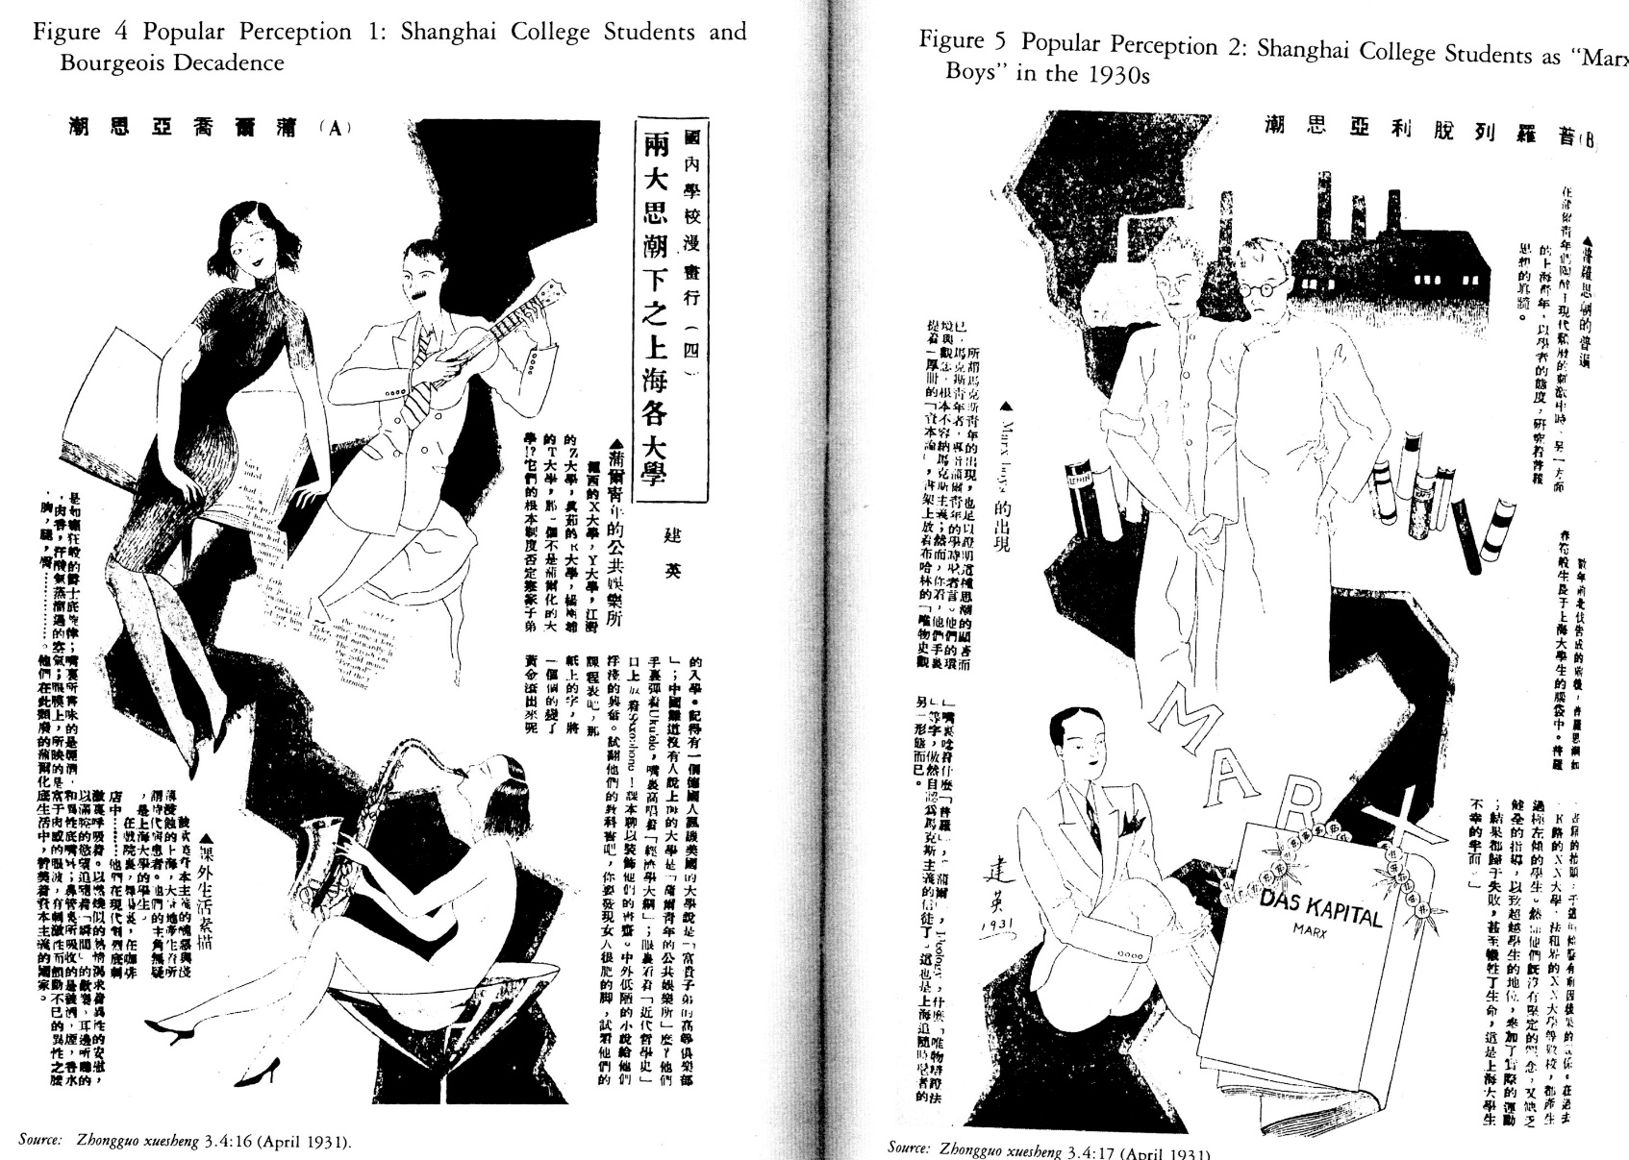
Images of College Students
Left: “Bourgeois Tide” Right: “Proletarian Tide”
From Chinese Student (1931)

