Slide 1
Changing Images of Women in Early 20th-Century Shanghai

Slide 2
“Pitiful Self-Expression”
Women in traditional dress pose uncomfortably in photography studio
Lithograph by Wu Youru (1850-1893)

Slide 3
“Acquiring a Different Taste”
Women in a Western-style dining room learning to eat with Western tableware
Lithograph by Wu Youru (1850-1893)

Slide 4
Many Faces of Qiu Jin
Qiu Jin (1877?-1907) took up the revolutionary cause in both politics and gender roles
Top left: conventional Chinese female dress
Top right: Japanese kimono with small sword
Bottom left: conventional Chinese male attire
Western male suit with cap and walking stick

Slide 5
“The Advance of Women’s Clothing: Improving the Vest”
Cartoon by Hu Yaguang, published in 1931, shows the evolution of women’s clothing since the late 19th century

Slide 6
1914 Cigarette Advertisement Calendar Poster
Zhou Muqiao, a leading figure in what becomes known as the Shanghai-style (海派) of painting, designed this poster for British-American Tobacco
The scene is a pastiche of Chinese clichés, but it also introduces the “modern woman” as a visual theme

Slide 7
Model in Qipao (Cheungsam)
The qipao (cheungsam in Cantonese), derived from Manchu women’s dress, became fashionable in the early 1920s-30s
Students, movie actresses, and calendar posters popularized this style, seen as more modest than Western dress

Slide 8
“How to Buy a New Dress”
Advertisement for silk goods store shows (at right) husband who “doesn’t like his wife”
She decides her clothing “isn’t fashionable”; after buying new clothes “husband looks at her with new eyes”

Slide 9
“Image of Nanjing Road”
Fashionable young lady juxtaposed with rural immigrant woman
Women stand in front of a Sincere Department Store window with mannequin wearing fur-lined coat

Slide 10
Calendar Poster with Qipao
This calendar poster from the 1930s shows women wearing qipao with Western fashion accessories

Slide 11
Art Imitates Life, Part I Left: Photo of Wu Huilan (Mrs. Wellington Koo), wife of one of China’s leading business tycoons Right: Calendar Art poster girl in identical pose

Slide 12
“Fashion Show”
Fashion trendsetters depicted in lifestyle magazine for women are mostly movie stars, notably “Miss Butterfly” (Hu Die) at lower left
From Young Companion (1933)

Slide 13
Calendar Poster
Dance hostesses dance the tango together
The dancers’ dresses, which copy French designs, and hairstyles date this illustration to ca. 1927
Background details indicate an actual place, the Great China Ballroom on North Sichuan Road

Slide 14
Art Imitates Life, Part II Left: Headshot of famed film actress Hu Die (“Butterfly”) Right: Calendar Art poster girl in likeness of Hu Die

Slide 15
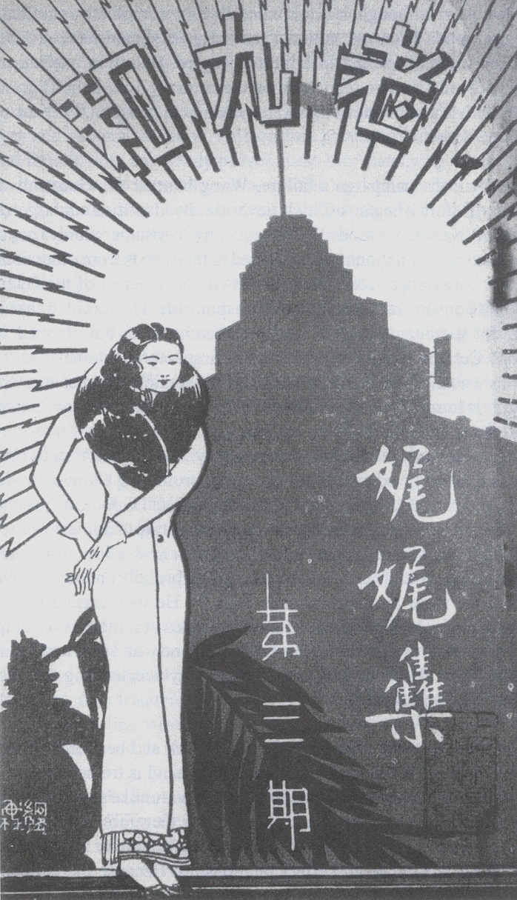
Images of Shanghai Women
Left: Fudan University college student
Right: Cover of advertising brochure from Lao Jiu He women’s clothing store

Slide 16
“Female Students”
As female students became associated with modish fashion,
brothels began to dress up their prostitutes as students
(and began to call their establishments “libraries”)

Slide 17
Ruan Lingyu
Cover of Young Companion from 1928 depicts the silent film movie star Ruan Lingyu
Publicity became a key to movie stardom success

Slide 18
Ruan Lingyu Still from “Life” (1934)
China’s most famous female movie star, Ruan committed suicide in 1935 at age 25
Made 29 films from 1929 to 1935
In “Life,” as in many of her films, Ruan plays a tragic heroine forced into prostitution

Slide 19
Ruan Lingyu in “The Goddess” (1934) She plays a prostitute trying to get a good education for her son, but is ostracized by society and winds up in prison

Slide 20
Ruan Lingyu in “Goodbye, Shanghai” (1934)
She plays a country lass who comes to Shanghai, is raped, and then is forced to work as a dance hall hostess

Slide 21
Newspaper Article on Ruan Lingyu’s funeral
Sensational coverage of Ruan’s suicide on International Woman’s Day (March 8) of 1935 was front-page news all over China
Over 100,000 people lined the route of her funeral procession to the cemetery

Slide 22
Cover Girls from Young Companion (良友畫報) Magazine, 1932-33

Slide 23
“One of Shanghai’s Famous Products”
Woman wears an exaggeratedly tight-clad qipao dress
1931 cartoon, published in Young Companion in 1935

Slide 24
“Model Women” of 1934
Photo montage published in the popular pictorial magazine, Young Companion (良友畫報)
See symbols in black ring for clues to the professions/activities of the pictured women

Slide 25
Cigarette Advertisement
Fashionable couple at leisure in modern home
Caption compares female beauty and cigarettes as both “lovely”
Also emphasizes that these cigarettes are “Made in China”

Slide 26
Cover of “Arts and Life” Magazine from 1934
Aimed at middle-class women readers, “Arts and Life” promoted a patriotic (“Buy Chinese Goods”) form of consumerism, but still showcased a distinctly “modern” (Western) lifestyle

Slide 27
“Typical Modern Home”
Rooms have distinct functional uses: parlor, bedroom, children’s room
Emphasis on fashion and cleanliness
From Young Companion (1930)

Slide 28
Mother and Children
This cigarette advertisement from the 1930s, in keeping with the new emphasis on domestic virtues, depicts an elegantly but conservatively dressed mother with children in Western clothing against a backdrop of a suburban Western-style home

