Slide 1
Systems Change
for Restorative
Justice in the
Nation’s Largest
Juvenile Justice System
AUGUST 1, 2023

Slide 2
Quick History of Juvenile Justice in the United States: Rehabilitation
19th Century emerging concept of modern childhood in the West
Activists in Chicago pushed for a distinct legal systems for children that would be less punitive than the adult system (parens patriae)
Beginnings of rehabilitative structures like child court, reformatories, and training schools
-Louise De Koven Bowen, President Juvenile Court Committee, Chicago 1904
Credit: How Chicago Women Created The World's First Juvenile Justice System : NPR
Notes:
SM

Slide 3
What We See Today
Disproportionate childhood trauma (ACEs) increases risk of criminalization and exposure to violence
+
Punishment stifles pro-social behavioral development
Increased likelihood of future incarceration and violence compared to youth offered alternatives
+
Impact of incarcerated relatives and intergenerational childhood trauma
Trauma, Criminalization, and Isolation as Punishment
The juvenile justice system got its start by mobilizing emerging youth development research into practice. As we learn about healing childhood trauma and preventing violence, our current juvenile legal system must do the same.
Notes:
SM
Justice Involved Youth
97% w/ 1+ ACEs
50% w/ 4+ ACEs
Non-Justice Involved Youth
66% w/ 1+ ACEs
-13% w/ 4+ ACEs

Slide 4
In a Restorative Approach to Youth Justice:
When wrongdoing / harm occurs,
The current criminal legal system asks: | Restorative Justice asks:
1. What law was broken? | 1. Who was wronged / harmed and what are their needs?
2. Who broke it? | 2. Whose obligation is it to meet those needs?
3. What punishment is deserved? And for juvenile justice in particular: what is required for rehabilitation? | 3. What is the appropriate process to involve stakeholders in putting things right and addressing underlying causes?
(adapted from Impact Justice: https://rjdtoolkit.impactjustice.org/establish-a-foundation/restorative-justice/)
Notes:
SM

Slide 5
In July 2022, The Department of Youth Development (DYD) was established, with the task of reimagining youth justice and implementing a “care-first” youth justice system that would be meaningfully different in process and outcomes from the current system.
DYD’s creation was an acknowledgement that youth justice system involvement is a social determinant of health that is both driven by and a major contributor to community disinvestment and structural racism.
What’s one thing you’d expect a “care-first” youth justice system to do?
Notes:
TS

Slide 6
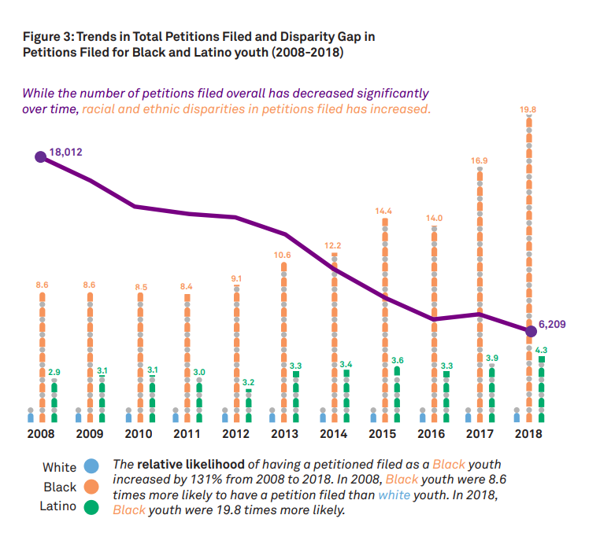
Fig. 1: Reduction in Overall Petitions Filed and Increase in Disparities by Race / Ethnicity in Los Angeles County, 2008 - 2018
Total
Notes:
TS
DYD’s Guiding Principles:
A healthy, safe future requires equitably healthy, thriving young people.
Any contact with the current juvenile justice system has serious negative impacts on health, academic, and economic outcomes for young people.
Although reforms in recent decades have coincided with decreases in the overall number of justice-involved youth, racial and ethnic disparities have increased in that time.
Investing in youth and community safety through equity-centered youth development has the potential to further reduce system involvement while decreasing disparities for youth of color and building restorative alternatives to address underlying causes of law-breaking and repair harm for survivors of crime.

Slide 7
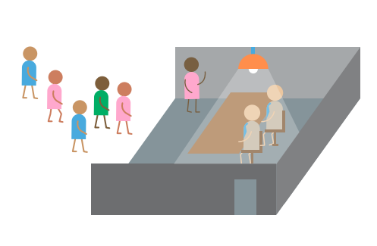
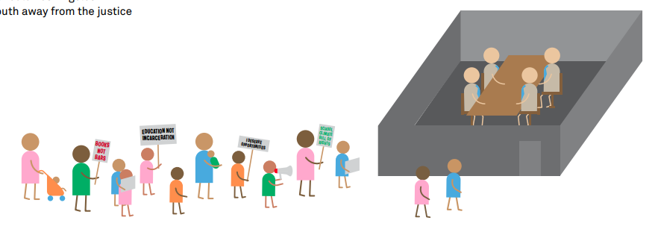
Phase 1: Impacted Youth and Community Leaders Push Local Government to Focus on Restorative Justice
Empowered by decades of youth and community organizing, youth leaders helped launch a collaborative program and policy planning process focused on designing restorative alternatives to youth arrest.
Our shared goal was to develop a public health approach to improving community wellbeing and safety by equitably reducing youth justice system involvement.
Notes:
TS

Slide 8
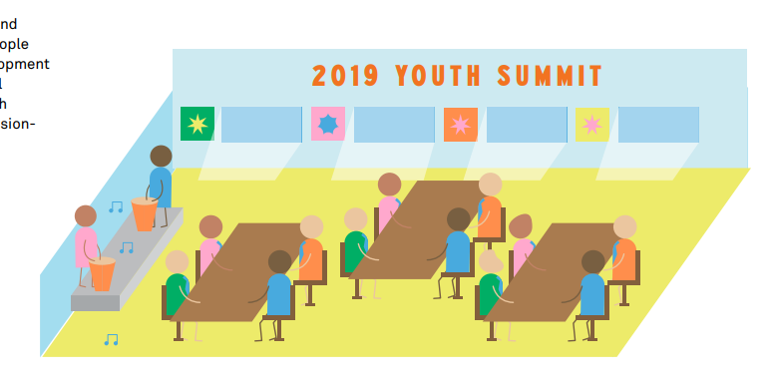
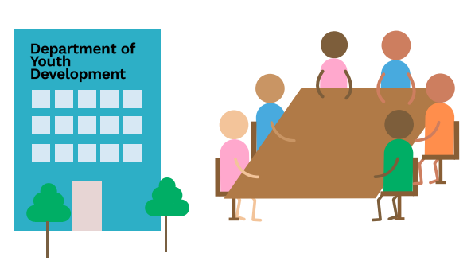
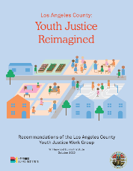
Phase 2: Building Sustainable Restorative Structures
First, the collaborative established a Youth Diversion program model that connects young people who would otherwise be arrested to community-based services, including restorative justice when appropriate.
Today, the Department of Youth Development is charged with building on those efforts to bring restorative practices to life at a systems level, both across the Department’s programs / policies and in other youth-serving systems.
Youth Development Summit in July 2019
Department of Youth Development
Welcome to DYD!
Notes:
TS

Slide 9
Notes:
TS

Slide 10
A Note on Systems Change:
Transformational Change:
Paradigms, Worldviews, Values, Beliefs
Structural Change:
Policies, Systems, Structures
Incremental Change:
Behaviors and Individual Responses
In movements for
justice transformation, “abolition” is both a verb and a noun.
It can mean both the process of moving through a specific type of sustainable, equitable systems change (verb) and a long-term vision for a specific type of transformational change (noun).
% Outcomes for
Sustainability & Equity
Notes:
TS + SM

Slide 11
Life-affirming ecosystem for all young people
(#SchoolsNotPrisons)
Restorative Justice
Status quo / increased investment in carceral system
Diversion with a focus on more serious cases without net widening with some efforts to reinvest
Decarceration for most youth with equivalent divestment / reinvestment of resources
Efforts to improve conditions of existing system with no structural change
Diversion with a focus on low-level cases, including net widening and reinforced surveillance / supervision
Notes:
SM

Slide 12
What Does RJ Look Like for Us?
Alternative to Arrest or Court Involvement
District Attorney’s Office
Law Enforcement Agencies
Case Dismissal
Expansion into Schools and Child Welfare
Youth record sealed
Access to ongoing community support
Diverted from formal system involvement
Community-led Facilitation
Preparation and relationship building by skilled facilitator
Respectful dialogue
Agreements (letter of apology, addressing underlying causes, financial compensation, etc.)
Initial Contact / Referral
District Attorney’s Office
Law Enforcement Agencies
Community-led Facilitation
Preparation and relationship building with person harmed or their proxy
Successful Diversion
Expansion into Schools / Child Welfare
Respectful dialogue to develop agreements (letter of apology, action to address underlying causes, etc.)
Access to ongoing community support
Record dismissed or sealed
Protections against use of statements to restrict leniency in future proceedings
Procedural alternatives rooted in
behavioral science, community values, critical systems analysis
Procedural alternatives rooted in
behavioral science, community values, critical systems analysis
Notes:
SM

Slide 13
What Does RJ Look Like for Us?
Youth Accountability
Healing & Harmed Parties
Right-sized agreements
Thoughtful engagement with actions and harm caused
Deeper understanding of and attention to psychosocial circumstances
Early intervention/prevention of repeat harms and further justice system involvement
Direct input towards meaningful resolution
Respect to the multilayered impact of harm
Centered in the agreements
Higher victim satisfaction*
Strengthened Community
Honors and empowers community-led safety efforts
Builds empathy, shared sense of community, and mutual respect between involved parties
Addresses unmet needs
*Victim satisfaction with restorative justice: More than simply procedural justice - Tinneke Van Camp, Jo-Anne Wemmers, 2013 (sagepub.com)
Notes:
SM + TS

Slide 14
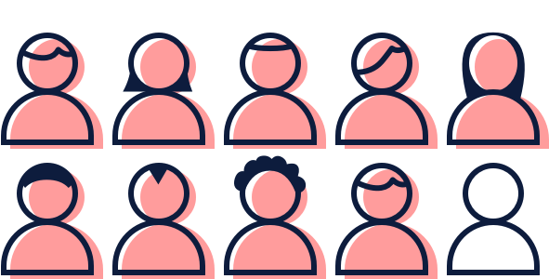
What is RJ’s Impact?
A growing body of research shows Restorative Justice is successful in:
Reducing recidivism,
Reducing costs compared to incarceration, and
Achieving high satisfaction among those who have been harmed.
About 90% of survivors of crime report
being satisfied with restorative justice
and would recommend it to others.
Notes:
TS

Slide 15
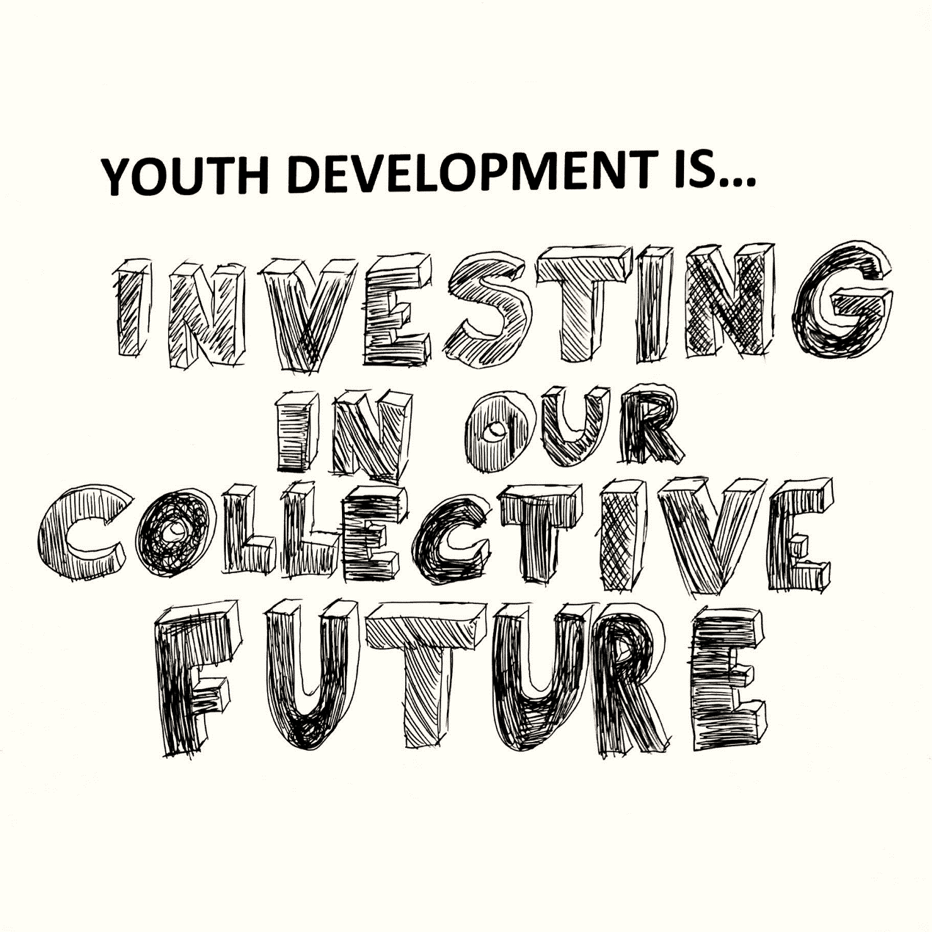
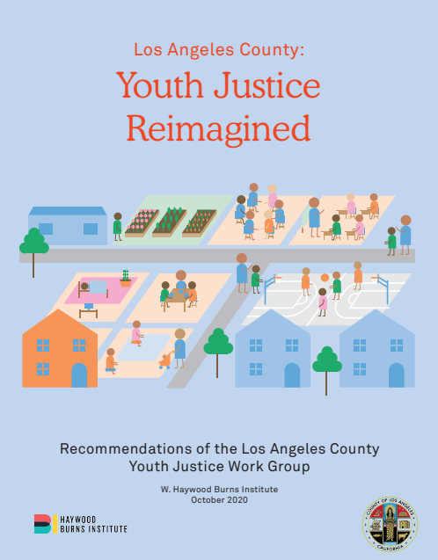
Phase 3: Reassessing What’s Possible
In a future where restorative structures have been equitably expanded, improved, and sustained, there is space to reassess the relevance of punitive systems and bring a reimagined approach to youth justice to life.
Reimagined safety looks like every young person and their family having what they need to be healthy, safe, and connected to supportive relationships that prevent crime, harm, and violence.
Reimagined accountability looks like every young person having access to restorative practices to repair the harm they’ve caused.
Notes:
TS

Slide 16
Summary: in Conversation with McLeod
Decriminalization
Decriminalizing truancy
Ending “voluntary probation” and fees/license holds for low-level citations
Expanding access to diversion without widening the net
Safe Spaces for Harm Prevention, Intervention, and Repair
Integrating Restorative Justice in schools and child welfare settings
Creating Youth Centers and Youth Empowerment and Support Teams
Supporting Credible Messenger Mentorship, community-based reentry care plans, & Safe Healing Centers
Justice Reinvestment
As equitable decriminalization reduces the footprint of the current system and safe spaces are expanded, improved, and shown to be effective…
Alternative Livelihoods
At every stage, employment opportunities are prioritized.
Community Investment / Development and Universal Design
With reinvestment, expanded opportunities for community development and design.

